Slide 1



CSS3, Bootstrap & TailwindCSS
A Comprehensive Guide for Beginners
CSS3
Bootstrap
TailwindCSS
3 Sessions | 6 Hours Total

Slide 2




Course Overview
Session 2: Advanced CSS3 & Bootstrap
Session 3: TailwindCSS & Comparison
Session 1: CSS3 Fundamentals
Introduction to CSS3
CSS Grid Layout
Introduction to TailwindCSS
The Box Model
Media Queries & Responsive Design
Tailwind Utilities
CSS Positioning
Introduction to Bootstrap
Building Components with Tailwind
Flexbox Layout
Bootstrap Components
Bootstrap vs TailwindCSS
Practice Exercises
Practice Exercises
Practice Exercises
2 hours with hands-on practice
2 hours with hands-on practice
2 hours with hands-on practice
Learning Objectives:
Understand CSS fundamentals and box model
Implement Bootstrap components effectively
Master Flexbox and Grid layouts
Build with TailwindCSS utility classes
Create responsive designs with media queries
Compare and choose between CSS frameworks

Slide 3

Introduction to CSS3
What is CSS?
How CSS Works with HTML
CSS (Cascading Style Sheets) is a style sheet language used for describing the presentation of a document written in HTML.
HTML provides the structure, while CSS provides the styling:
Evolution of CSS
CSS (Presentation)
CSS1 (1996): Basic styling capabilities
CSS2 (1998): Added positioning, z-index, media types
div {
background-color: #f0f0f0;
padding: 20px;
}
h1 {
color: blue;
}
p {
font-size: 16px;
}
CSS3 (2001-present): Modular approach with many new features
HTML (Structure)
CSS3 Features
<div>
<h1>Hello World</h1>
<p>This is a paragraph.</p>
</div>
Animations and transitions
Multiple backgrounds
Gradients and shadows
Flexbox and Grid layouts
Media queries for responsive design
Further Reading:
MDN Web Docs - CSS
|
Web.dev - Learn CSS
Browser Rendering Process
Browser loads HTML (creates DOM)
Browser loads CSS (creates CSSOM)
DOM + CSSOM = Render Tree
Layout calculation (sizing and positioning)
Painting the page

Slide 4
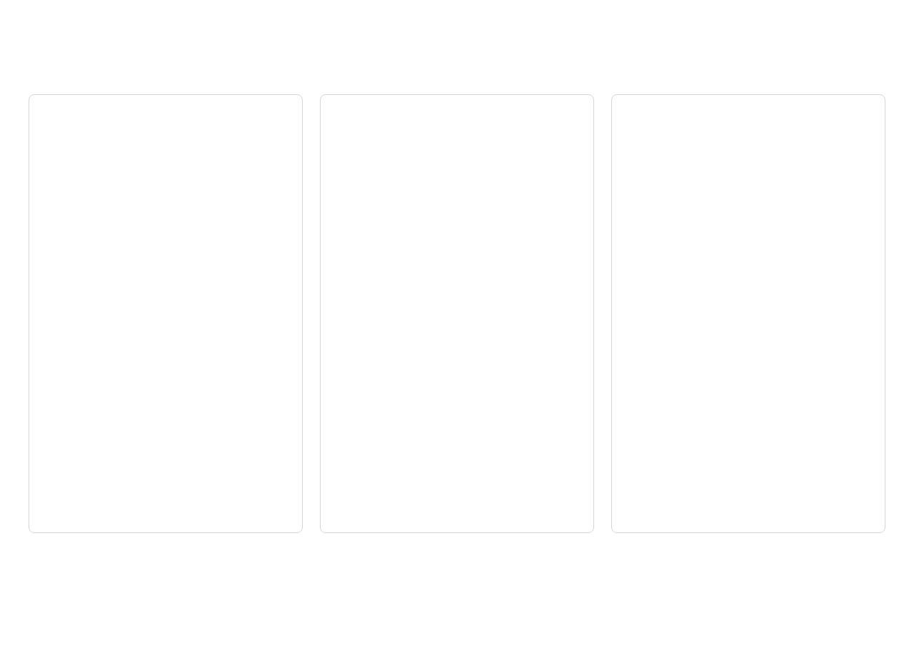
Ways to Include CSS
1. Inline CSS
2. Internal CSS
3. External CSS
Using the
Linking to an external .css file
attribute directly in HTML elements
Using the
tag in the
section
style
<style>
<head>
<head>
<style>
p {
color: blue;
font-size: 16px;
margin: 10px;
}
</style>
</head>
<head>
<link rel="stylesheet"
href="styles.css">
</head>
<p style="color: blue;
font-size: 16px;
margin: 10px;">
This is a paragraph.
</p>
In styles.css:
Pros:
p {
color: blue;
font-size: 16px;
margin: 10px;
}
Highest specificity
Quick for testing
Cons:
Pros:
Mixes content with presentation
No extra files needed
Hard to maintain
Styles apply to whole page
No reusability
Cons:
Increases page size
Pros:
No reuse across pages
Separation of concerns
Mixing structure with style
Reusable across pages
Browser caching
Cons:
Further Reading:
MDN - How CSS is structured
|
W3Schools - How to Add CSS
Extra HTTP request
May delay rendering
Best Practices:
Use external CSS for most projects
Inline CSS only for testing or email templates
Internal CSS for single-page applications
Follow the principle of separation of concerns

Slide 5
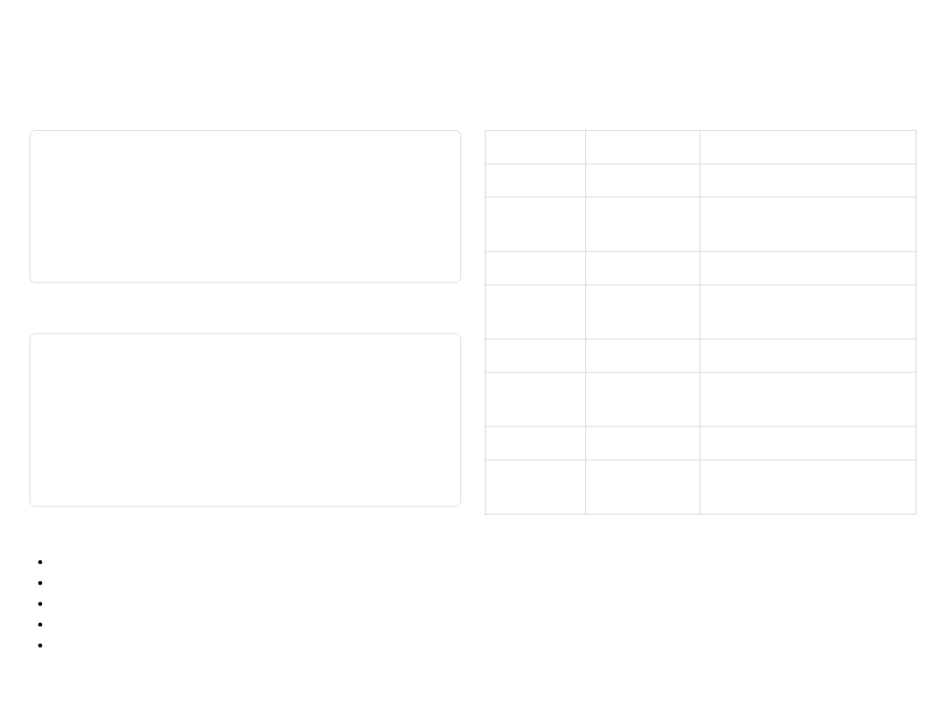
CSS Syntax & Selectors
Basic CSS Syntax
Common CSS Selectors
Selector Type
Example
Description
selector {
property: value;
another-property: value;
}
Element
Selects all <p> elements
p { }
Class
Selects all elements with class="info"
.info { }
ID
Selects element with id="header"
#header { }
Attribute
Selects elements with type="text"
Example:
[type="text"] { }
Pseudo-class
Selects links when hovered
a:hover { }
h1 {
color: blue;
font-size: 24px;
margin-bottom: 10px;
}
Pseudo-element
Selects first line of <p> elements
p::first-line { }
Descendant
Selects <p> inside <div>
div p { }
Child
Selects <p> that are direct children of <div>
div > p { }
Further Reading:
MDN - CSS Selectors
|
CSS-Tricks - Specificity
CSS Rule Components:
Selector Specificity:
Selector:
Targets HTML elements
When multiple rules target the same element, specificity determines which rule applies:
Declaration block:
Contains declarations
Declaration:
Property-value pair
Property:
Aspect to style
Inline styles (highest)
Value:
Setting for the property
IDs
Classes, attributes, pseudo-classes
Elements, pseudo-elements (lowest)

Slide 6
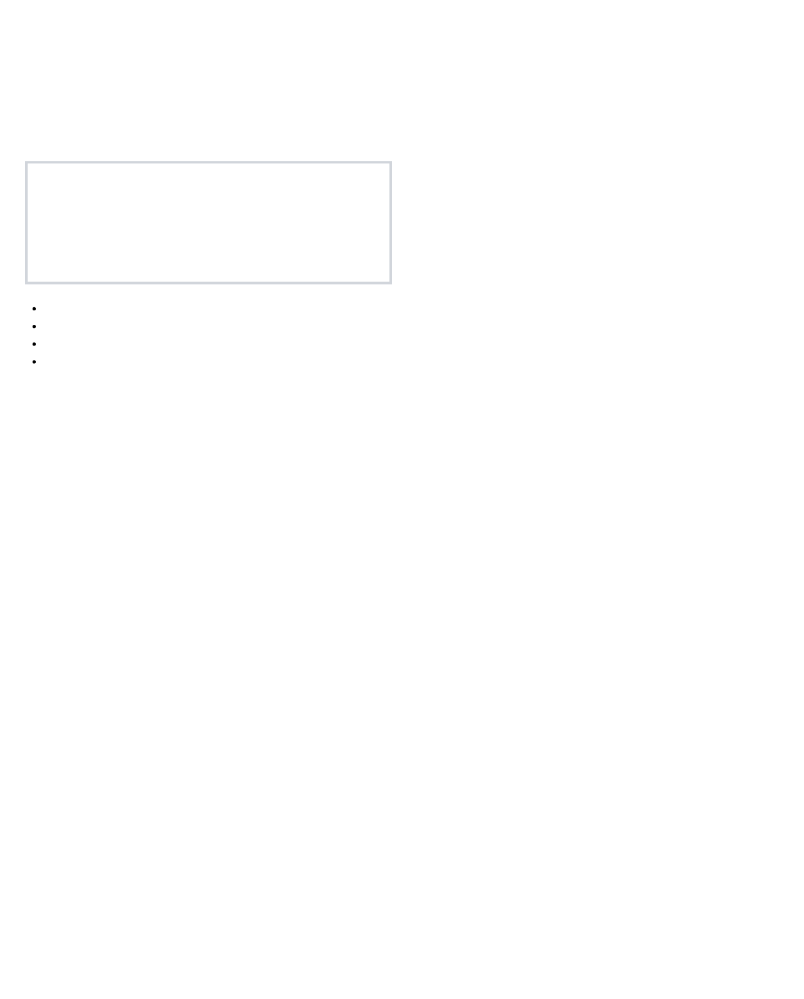
The Box Model
Understanding the CSS Box Model
Box Model Properties
Every HTML element is represented as a rectangular box with four components:
Content Dimensions
div {
width: 300px;
height: 200px;
}
Margin
Border
Padding
Content
Padding
div {
padding: 20px; /* All sides */
padding-top: 10px; /* Top only */
padding-right: 15px; /* Right only */
padding-bottom: 10px; /* Bottom only */
padding-left: 15px; /* Left only */
/* Shorthand: top right bottom left */
padding: 10px 15px 10px 15px;
/* Shorthand: top/bottom right/left */
padding: 10px 15px;
}
Content:
The actual content of the element (text, images, etc.)
Padding:
Space between content and border
Border:
Line around the padding
Margin:
Space outside the border
Further Reading:
MDN - Introduction to the CSS box model
|
CSS-Tricks - The CSS Box Model
Border
div {
border: 1px solid black; /* width style color */
border-width: 2px;
border-style: dashed;
border-color: #333;
/* Individual sides */
border-top: 1px solid red;
border-right: 2px dotted blue;
}
Margin
div {
margin: 20px; /* All sides */
margin-top: 10px; /* Top only */
/* Shorthand: same as padding */
margin: 10px 15px 10px 15px;
margin: 10px 15px;
}

Slide 7
Box-Sizing Property
The Problem with Default Box Model
The Solution: box-sizing Property
By default, the
properties in CSS only apply to the content area, not including padding and border.
width
and
height
border-box
Default Box Model (content-box)
div {
box-sizing: border-box;
width: 300px;
padding: 20px;
border: 10px solid black;
}
/* Total width: 300px (includes padding and border) */
div {
width: 300px;
padding: 20px;
border: 10px solid black;
}
/* Total width: 300px + 40px (padding) + 20px (border) = 360px */
With
properties include padding and border, making layout calculations much easier.
box-sizing: border-box
, the
width
and
height
This can make layout calculations difficult and unintuitive.
Total Width: 300px
Total Width: 360px
Content Area
Content Area (width: 300px)
Further Reading:
MDN - box-sizing
|
CSS-Tricks - Box Sizing
Border: 10px
Padding: 20px
Best Practice: Global Reset
*, *::before, *::after {
box-sizing: border-box;
}
/* Apply border-box to all elements and pseudo-elements */
This is a common practice in modern CSS frameworks like Bootstrap and Tailwind CSS.

Slide 8
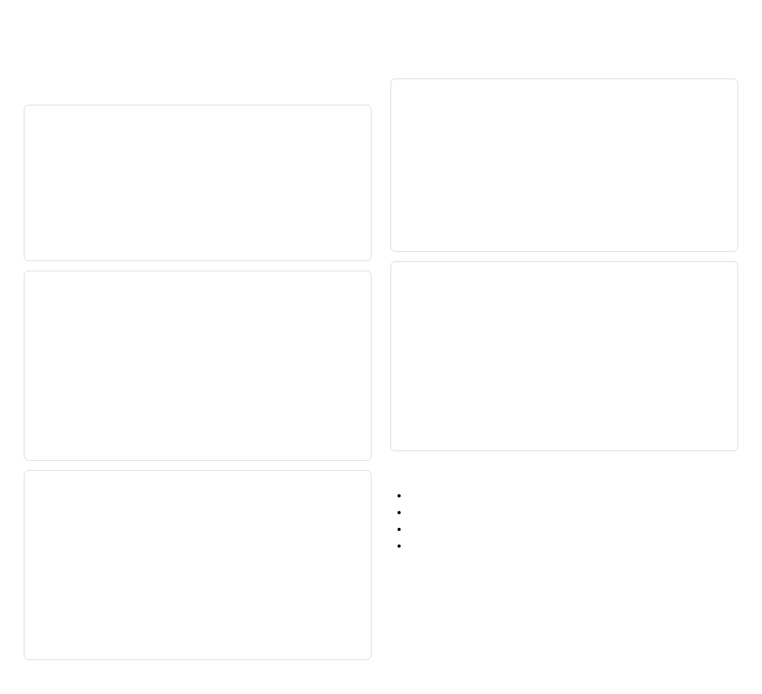
CSS Positioning
Position Property Values
Fixed
Static (Default)
div {
position: fixed;
bottom: 20px;
right: 30px;
}
div {
position: static;
}
Elements are positioned according to the normal document flow. The
Positioned relative to the viewport. Stays in place even when scrolling.
,
,
, and
properties have no effect.
top
right
bottom
left
Sticky
Relative
div {
position: sticky;
top: 0;
}
div {
position: relative;
top: 20px;
left: 30px;
}
Behaves like
until it crosses a specified threshold, then behaves like
relative
Further Reading:
MDN - position
|
CSS-Tricks - Position
. Useful for navigation bars that stick when scrolling.
Positioned relative to its normal position. Creates a positioning context for absolute children.
fixed
Offset Properties
Absolute
top
: Distance from the top edge
right
: Distance from the right edge
div {
position: absolute;
top: 20px;
right: 30px;
}
bottom
: Distance from the bottom edge
left
: Distance from the left edge
Practice Tip:
When using absolute positioning, always ensure the parent element has a position value other than static (usually relative) to create a positioning context.
Positioned relative to the nearest positioned ancestor (not static). If none exists, relative to the initial containing block.

Slide 9
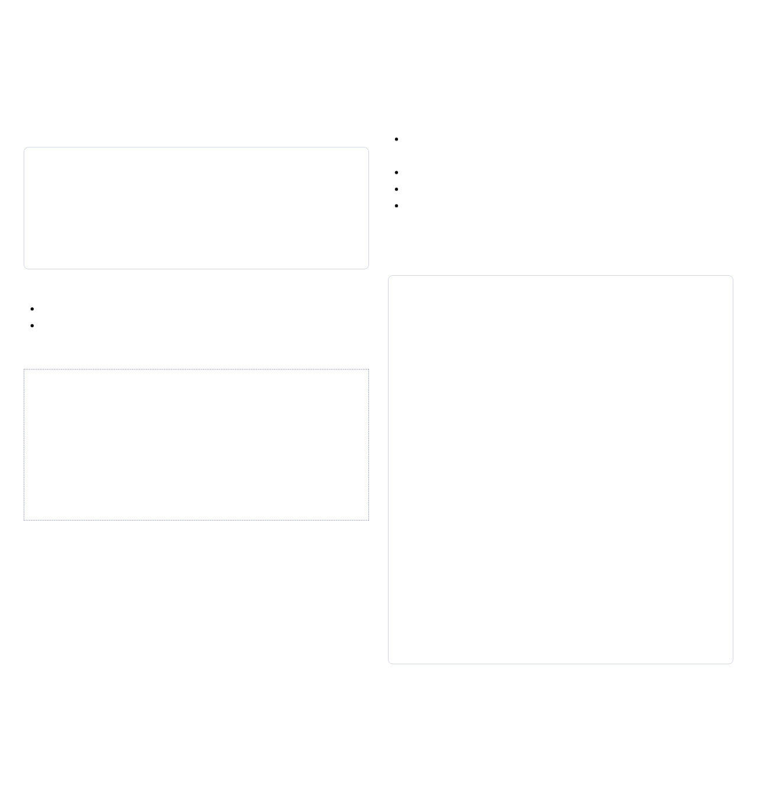
Z-Index & Stacking
Understanding Z-Index
Stacking Context
The
A stacking context is formed by any element that:
property controls the vertical stacking order of elements that overlap.
z-index
Has a
position
value other than
static
with a
z-index
value other than
auto
Has
opacity
less than 1
div {
position: relative;
z-index: 10;
}
Has
,
, or
properties
transform
filter
perspective
Has
position: fixed
or
sticky
Stacking Context Hierarchy
Z-index values only compete within the same stacking context.
Higher values appear on top of elements with lower values
Only works on positioned elements (not
)
static
/* Parent creates a stacking context */
.parent {
position: relative;
z-index: 1;
}
/* Child with higher z-index */
.child {
position: absolute;
z-index: 100;
}
/* Another element outside parent */
.other {
position: relative;
z-index: 2;
}
/* .other (z-index: 2) will appear above .child (z-index: 100)
because .child is in a stacking context with z-index: 1 */
Default value is
auto
(treated as 0)
Can be positive or negative integers
z-index: 1
Further Reading:
MDN - z-index
|
CSS-Tricks - z-index
z-index: 2
z-index: 3
Common Use Cases:
Modal dialogs and overlays
Dropdown menus
Tooltips and popovers
Fixed navigation bars

Slide 10
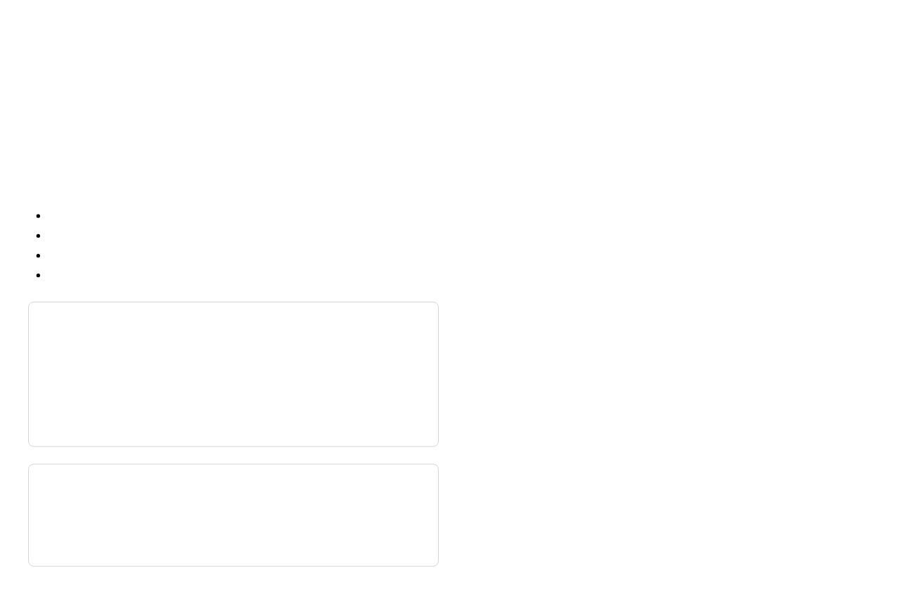
Flexbox Layout
What is Flexbox?
Why Use Flexbox?
Flexbox (Flexible Box Layout) is a one-dimensional layout method designed for laying out items in rows or columns.
Simplifies complex layouts
Automatically distributes space
Controls alignment in both directions
Key Concepts:
Reorders elements without changing HTML
Flex Container:
Parent element with
display: flex
Creates responsive designs easily
Flex Items:
Direct children of the flex container
Main Axis:
Primary axis (horizontal for row, vertical for column)
Common Use Cases:
Cross Axis:
Perpendicular to the main axis
Navigation menus
Card layouts
Form controls
Centering elements
/* Basic Flexbox Container */
.container {
display: flex;
}
Equal-height columns
Browser Support:
Flexbox is supported in all modern browsers:
Chrome 29+
Firefox 22+
Further Reading:
MDN - Basic Concepts of Flexbox
|
CSS-Tricks - A Complete Guide to Flexbox
Safari 6.1+
Item 1
Item 2
Item 3
Edge 12+
Opera 12.1+
Basic flex container with items in a row
iOS Safari 7.1+
Android Browser 4.4+

Slide 11
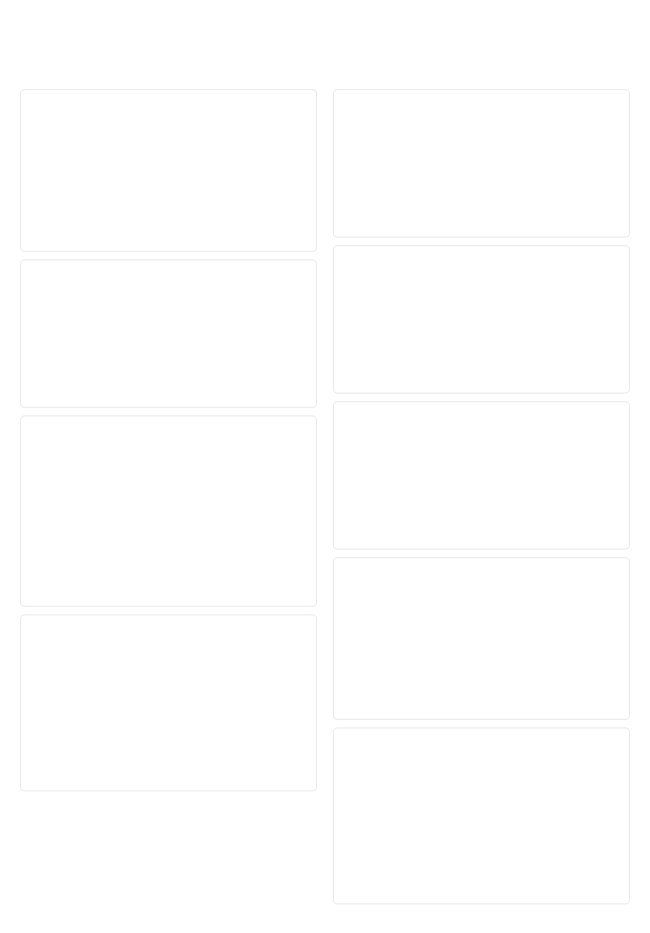
Flexbox Properties
Container Properties
Item Properties
flex-direction
flex-grow
/* Defines the direction of the main axis */
.container {
flex-direction: row; /* default */
/* flex-direction: row-reverse; */
/* flex-direction: column; */
/* flex-direction: column-reverse; */
}
/* Ability to grow if necessary */
.item {
flex-grow: 0; /* default - does not grow */
/* flex-grow: 1; */ /* grows to fill space */
/* flex-grow: 2; */ /* grows twice as much as others */
}
flex-shrink
flex-wrap
/* Ability to shrink if necessary */
.item {
flex-shrink: 1; /* default - can shrink */
/* flex-shrink: 0; */ /* cannot shrink */
/* flex-shrink: 2; */ /* shrinks twice as much */
}
/* Controls whether items wrap to new lines */
.container {
flex-wrap: nowrap; /* default */
/* flex-wrap: wrap; */
/* flex-wrap: wrap-reverse; */
}
Further Reading:
MDN - CSS Flexible Box Layout
|
CSS-Tricks - A Complete Guide to Flexbox
flex-basis
justify-content
/* Default size before growing/shrinking */
.item {
flex-basis: auto; /* default - use item's size */
/* flex-basis: 0; */ /* start from zero size */
/* flex-basis: 200px; */ /* start from 200px */
}
/* Aligns items along the main axis */
.container {
justify-content: flex-start; /* default */
/* justify-content: flex-end; */
/* justify-content: center; */
/* justify-content: space-between; */
/* justify-content: space-around; */
/* justify-content: space-evenly; */
}
flex (shorthand)
/* Shorthand for grow, shrink, and basis */
.item {
flex: 0 1 auto; /* default */
/* flex: 1; */ /* same as flex: 1 1 0% */
/* flex: auto; */ /* same as flex: 1 1 auto */
/* flex: none; */ /* same as flex: 0 0 auto */
}
align-items
/* Aligns items along the cross axis */
.container {
align-items: stretch; /* default */
/* align-items: flex-start; */
/* align-items: flex-end; */
/* align-items: center; */
/* align-items: baseline; */
}
align-self
/* Override alignment for specific items */
.item {
align-self: auto; /* default - inherit from parent */
/* align-self: flex-start; */
/* align-self: flex-end; */
/* align-self: center; */
/* align-self: stretch; */
}

Slide 12

Practice: Flexbox
Exercise 1: Create a Centered Card
Exercise 2: Build a Navigation Bar
HTML Structure
HTML Structure
<div class="container">
<div class="card">
<h2>Card Title</h2>
<p>This is a card content that needs to be
centered both horizontally and vertically.</p>
<button>Click Me</button>
</div>
</div>
<nav class="navbar">
<div class="logo">Logo</div>
<ul class="nav-links">
<li><a href="#">Home</a></li>
<li><a href="#">About</a></li>
<li><a href="#">Services</a></li>
<li><a href="#">Contact</a></li>
</ul>
</nav>
CSS Solution
CSS Solution
.container {
display: flex;
justify-content: center;
align-items: center;
height: 100vh;
}
.card {
width: 300px;
padding: 20px;
border: 1px solid #ccc;
border-radius: 8px;
text-align: center;
}
.card button {
margin-top: 10px;
padding: 8px 16px;
background-color: #333;
color: white;
border: none;
border-radius: 4px;
cursor: pointer;
}
.navbar {
display: flex;
justify-content: space-between;
align-items: center;
padding: 1rem 2rem;
background-color: #f5f5f5;
}
.logo {
font-weight: bold;
font-size: 1.5rem;
}
.nav-links {
display: flex;
list-style: none;
margin: 0;
padding: 0;
}
.nav-links li {
margin-left: 1.5rem;
}
.nav-links a {
text-decoration: none;
color: #333;
transition: color 0.3s ease;
}
.nav-links a:hover {
color: #666;
}
Further Reading:
Flexbox Froggy - Interactive Learning Game
|
MDN - Typical Use Cases of Flexbox
Challenge:
Create a simple layout with:
Header at the top
Main content in the middle
Footer at the bottom
Use flexbox to ensure the footer stays at the bottom even with minimal content

Slide 13
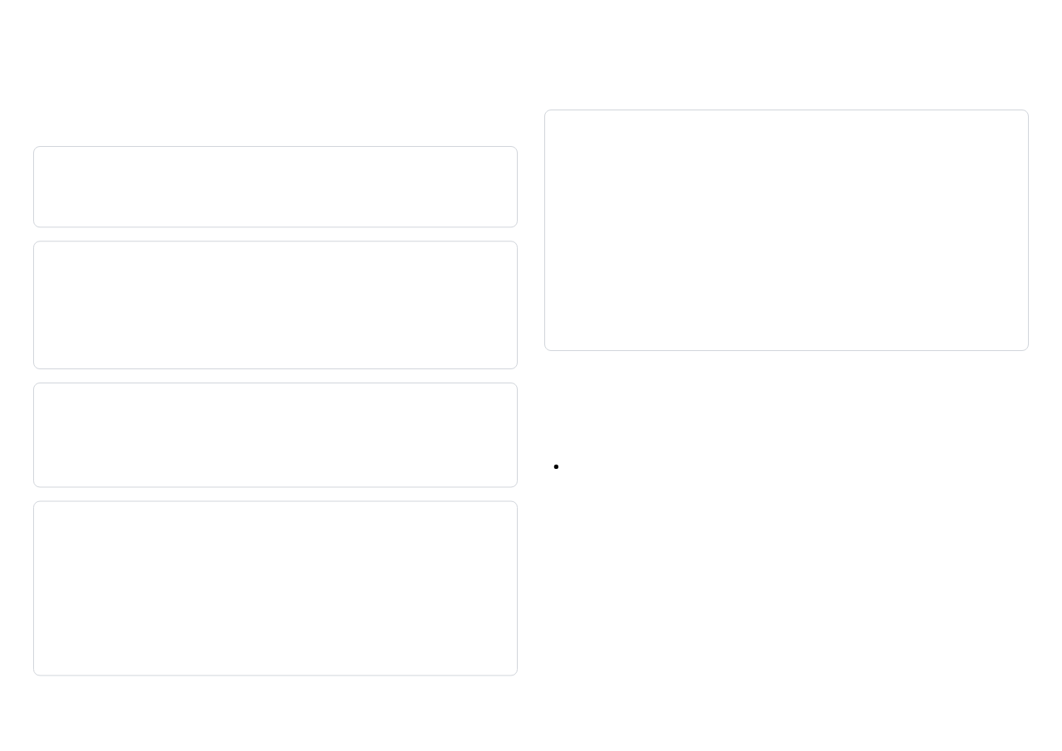
Session 1: Assessment
Quick Quiz
5. How do you center an element horizontally and vertically using flexbox?
1. What are the four components of the CSS box model?
Answer: Content, Padding, Border, and Margin
.container {
display: flex;
justify-content: center;
align-items: center;
}
2. What is the difference between margin and padding?
Answer: Padding is the space between content and border (inside the element), while margin is the space outside the border (between elements).
Key Takeaways from Session 1
3. How does box-sizing: border-box change the box model?
CSS controls the presentation and layout of web pages
Answer: It includes padding and border in the element's width and height calculations, making layout more predictable.
The box model is fundamental to understanding CSS layout
Use
box-sizing: border-box
for more intuitive sizing
Different positioning methods serve different layout needs
Flexbox simplifies many common layout tasks
4. What is the difference between position: relative and position: absolute?
Further Reading:
MDN - CSS Layout
|
CSS-Tricks - Guides
Homework Assignment:
Answer: Relative positioning offsets an element from its normal position while keeping its space in the document flow. Absolute positioning removes the element from the document flow and positions it relative to its nearest positioned ancestor.
Create a simple webpage with:
A header with navigation links using flexbox
A main content area with at least two columns
A card component with proper padding and border
A footer that stays at the bottom of the page

Slide 14
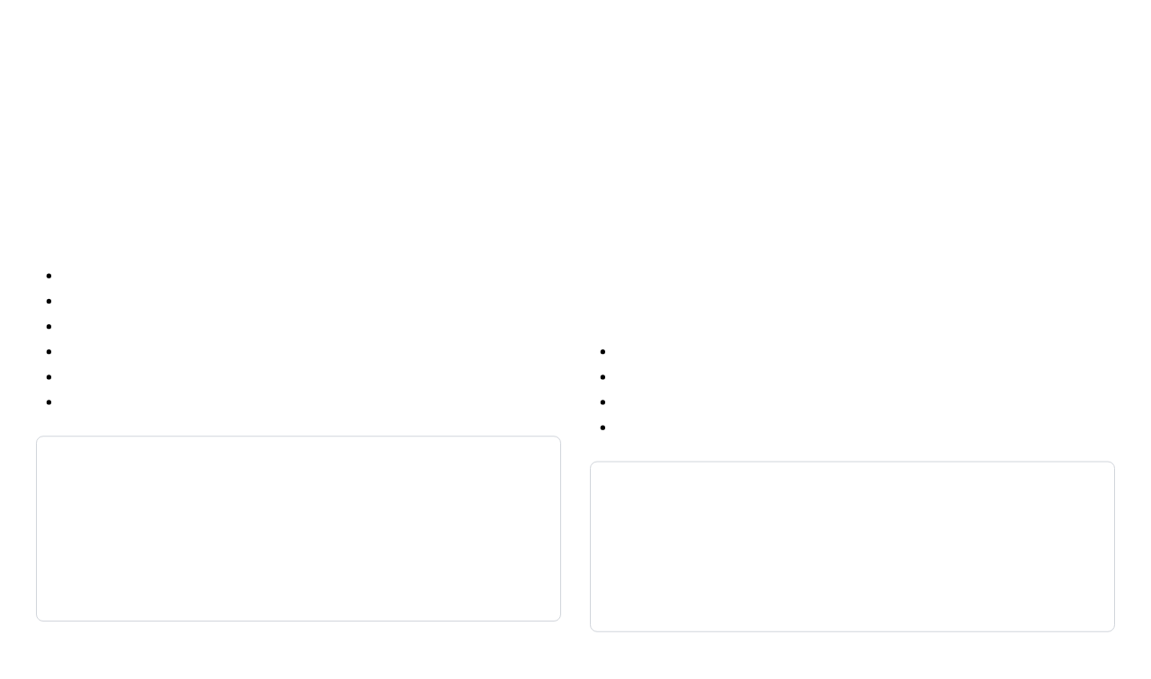
CSS Grid Layout
What is CSS Grid?
Why Use CSS Grid?
CSS Grid Layout is a two-dimensional layout system designed for organizing content in rows and columns.
Creates complex two-dimensional layouts
Simplifies layout code
Provides precise control over placement
Key Concepts:
Enables responsive designs without media queries
Grid Container:
Parent element with
display: grid
Works well with Flexbox for complete layouts
Grid Items:
Direct children of the grid container
Grid Lines:
Dividing lines that make up the grid structure
Flexbox vs. Grid:
Grid Tracks:
Rows and columns of the grid
Flexbox:
One-dimensional layout (row OR column)
Grid Cells:
Individual units where content is placed
Grid:
Two-dimensional layout (rows AND columns)
Grid Areas:
Rectangular spaces made up of multiple cells
Flexbox:
Content-first approach
Grid:
Layout-first approach
/* Basic Grid Container */
.container {
display: grid;
}
Item 1
Item 2
Item 3
Item 4
Item 5
Item 6
Further Reading:
MDN - CSS Grid Layout
|
CSS-Tricks - A Complete Guide to Grid
Basic grid layout with 3 columns

Slide 15
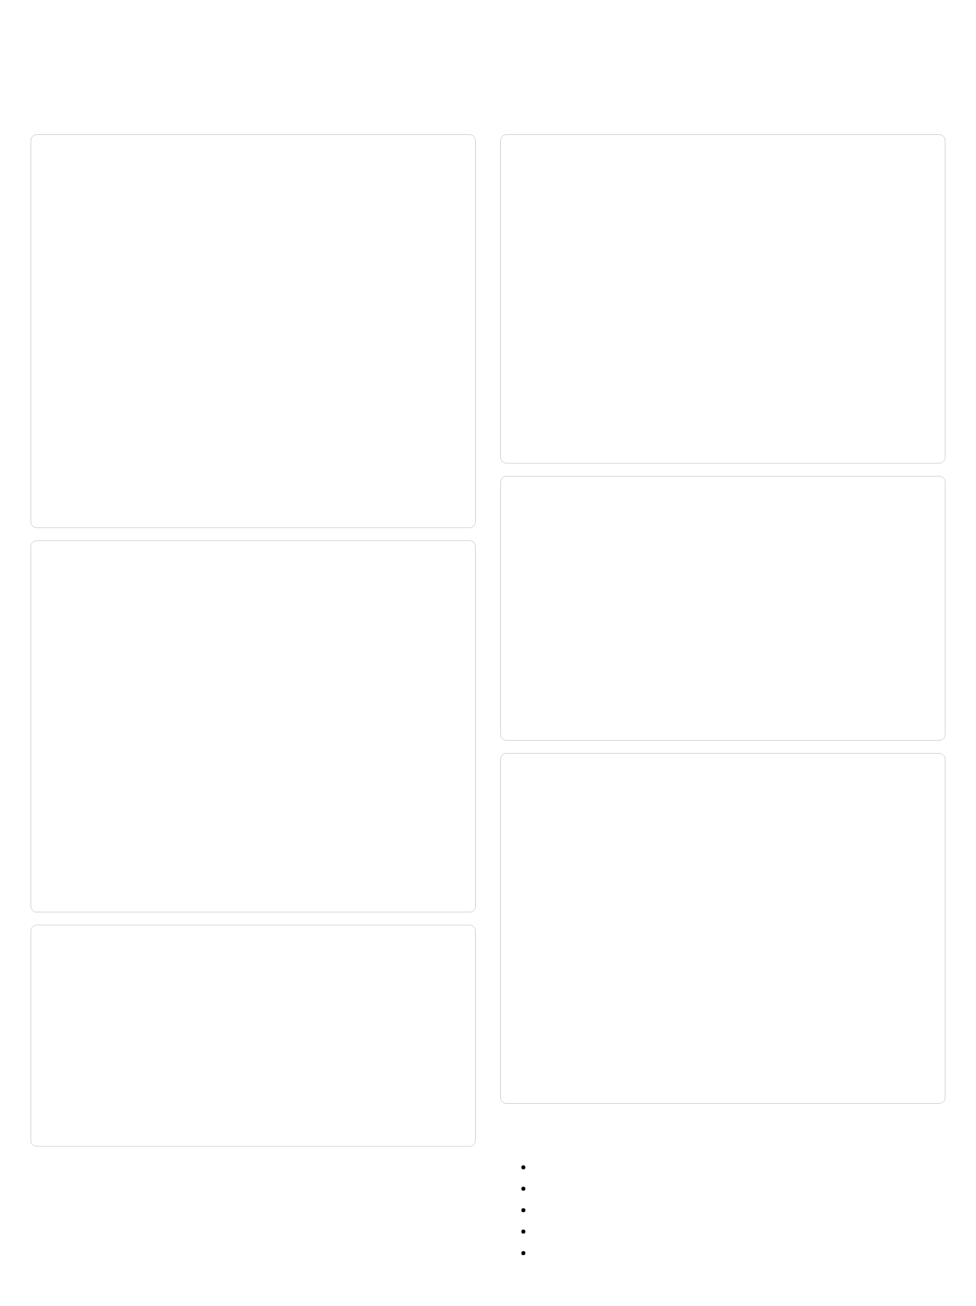
Grid Properties
Container Properties
Item Properties
grid-template-columns / grid-template-rows
grid-column / grid-row
/* Define columns and rows */
.container {
grid-template-columns: 100px 200px 100px;
grid-template-rows: auto 100px auto;
/* Using repeat() function */
grid-template-columns: repeat(3, 1fr);
/* Using fractional units */
grid-template-columns: 1fr 2fr 1fr;
/* Using minmax() function */
grid-template-columns: minmax(100px, 1fr) 2fr 1fr;
}
/* Position items by grid lines */
.item {
grid-column: 1 / 3; /* start at line 1, end at line 3 */
grid-row: 2 / 4; /* start at line 2, end at line 4 */
/* Shorthand for span */
grid-column: 1 / span 2; /* start at line 1, span 2 tracks */
/* Negative values count from end */
grid-column: 1 / -1; /* start at line 1, end at last line */
}
grid-area
Further Reading:
MDN - Basic Concepts of Grid Layout
|
Grid by Example
/* Shorthand for grid-row-start, grid-column-start,
grid-row-end, grid-column-end */
.item {
grid-area: 2 / 1 / 4 / 3;
/* Or assign to named area */
grid-area: header;
}
grid-template-areas
/* Define named grid areas */
.container {
grid-template-areas:
"header header header"
"sidebar main main"
"footer footer footer";
}
/* Target elements to specific areas */
.header { grid-area: header; }
.sidebar { grid-area: sidebar; }
.main { grid-area: main; }
.footer { grid-area: footer; }
justify-self / align-self
/* Control item alignment within its cell */
.item {
justify-self: start; /* horizontal alignment */
/* justify-self: end; */
/* justify-self: center; */
/* justify-self: stretch; */ /* default */
align-self: start; /* vertical alignment */
/* align-self: end; */
/* align-self: center; */
/* align-self: stretch; */ /* default */
}
grid-gap (gap)
/* Set spacing between grid cells */
.container {
gap: 20px; /* all gaps */
row-gap: 10px; /* only between rows */
column-gap: 20px; /* only between columns */
}
Grid Terminology:
Grid Lines:
Numbered from 1 at the start
Grid Tracks:
Space between adjacent grid lines
fr unit:
Fractional unit, shares available space
minmax():
Sets minimum and maximum size
auto-fill/auto-fit:
Creates responsive tracks

Slide 16
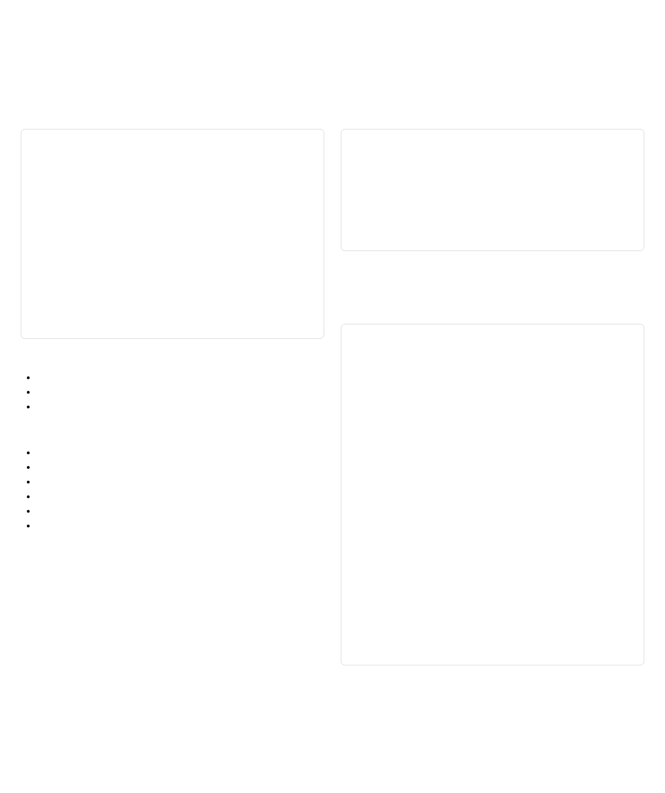
Media Queries & Responsive Design
What are Media Queries?
The Viewport
Media queries allow you to apply CSS styles based on device characteristics, such as screen width, height, or orientation.
The viewport is the visible area of a web page. On mobile devices, the viewport is often different from the screen width.
Basic Syntax
Viewport Meta Tag
@media media-type and (condition) {
/* CSS rules to apply when condition is true */
}
/* Example */
@media screen and (max-width: 768px) {
.container {
width: 100%;
}
}
<meta name="viewport"
content="width=device-width, initial-scale=1.0">
This tag tells the browser to set the viewport width to the device width and set the initial zoom level to 1.0 (no zoom).
Mobile-First Approach
Start with styles for mobile devices, then add media queries for larger screens.
Common Media Types:
/* Base styles for mobile */
.container {
width: 100%;
padding: 15px;
}
/* Styles for tablets and up */
@media (min-width: 768px) {
.container {
width: 750px;
margin: 0 auto;
}
}
/* Styles for desktops */
@media (min-width: 992px) {
.container {
width: 970px;
}
}
Further Reading:
MDN - Using Media Queries
|
Web.dev - Responsive Web Design Basics
screen
: Computer screens, tablets, phones
print
: Print preview mode/printed pages
all
: All media types (default)
Common Media Features:
,
,
width
min-width
max-width
,
,
height
min-height
max-height
orientation
: portrait or landscape
aspect-ratio
resolution
prefers-color-scheme
: light or dark
Common Breakpoints:
Small devices (phones): 576px
Medium devices (tablets): 768px
Large devices (desktops): 992px
Extra large devices: 1200px

Slide 17
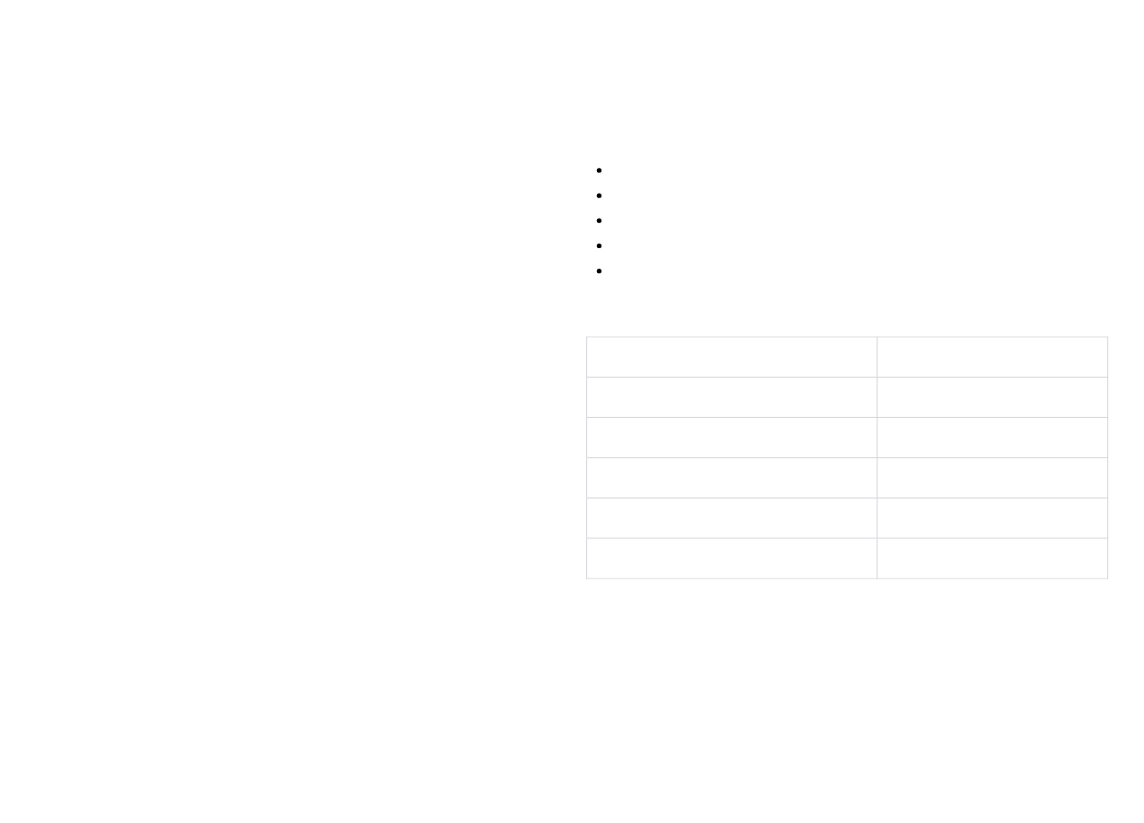
Introduction to Bootstrap
What is Bootstrap?
Why Use Bootstrap?
Bootstrap is the most popular CSS framework for developing responsive and mobile-first websites.
Speed of Development:
Ready-to-use components
Consistency:
Uniform look across pages
Responsiveness:
Mobile-first approach
Key Features:
Community Support:
Large community and resources
Responsive grid system
Customization:
Can be tailored to your needs
Pre-built components
JavaScript plugins
Bootstrap vs. Custom CSS:
Consistent design
Bootstrap
Custom CSS
Cross-browser compatibility
Customizable
Faster development
More control
Consistent design
Unique design
History:
Created by Twitter in 2011
Larger file size
Smaller file size
Originally called "Twitter Blueprint"
Community support
Self-reliance
Current version: Bootstrap 5
No longer depends on jQuery (since v5)
Similar to other sites
Distinctive look
Further Reading:
Bootstrap Documentation
|
Bootstrap Blog
When to Use Bootstrap:
Rapid prototyping
Admin dashboards
Small to medium projects
When consistency is more important than uniqueness
When team is familiar with Bootstrap

Slide 18
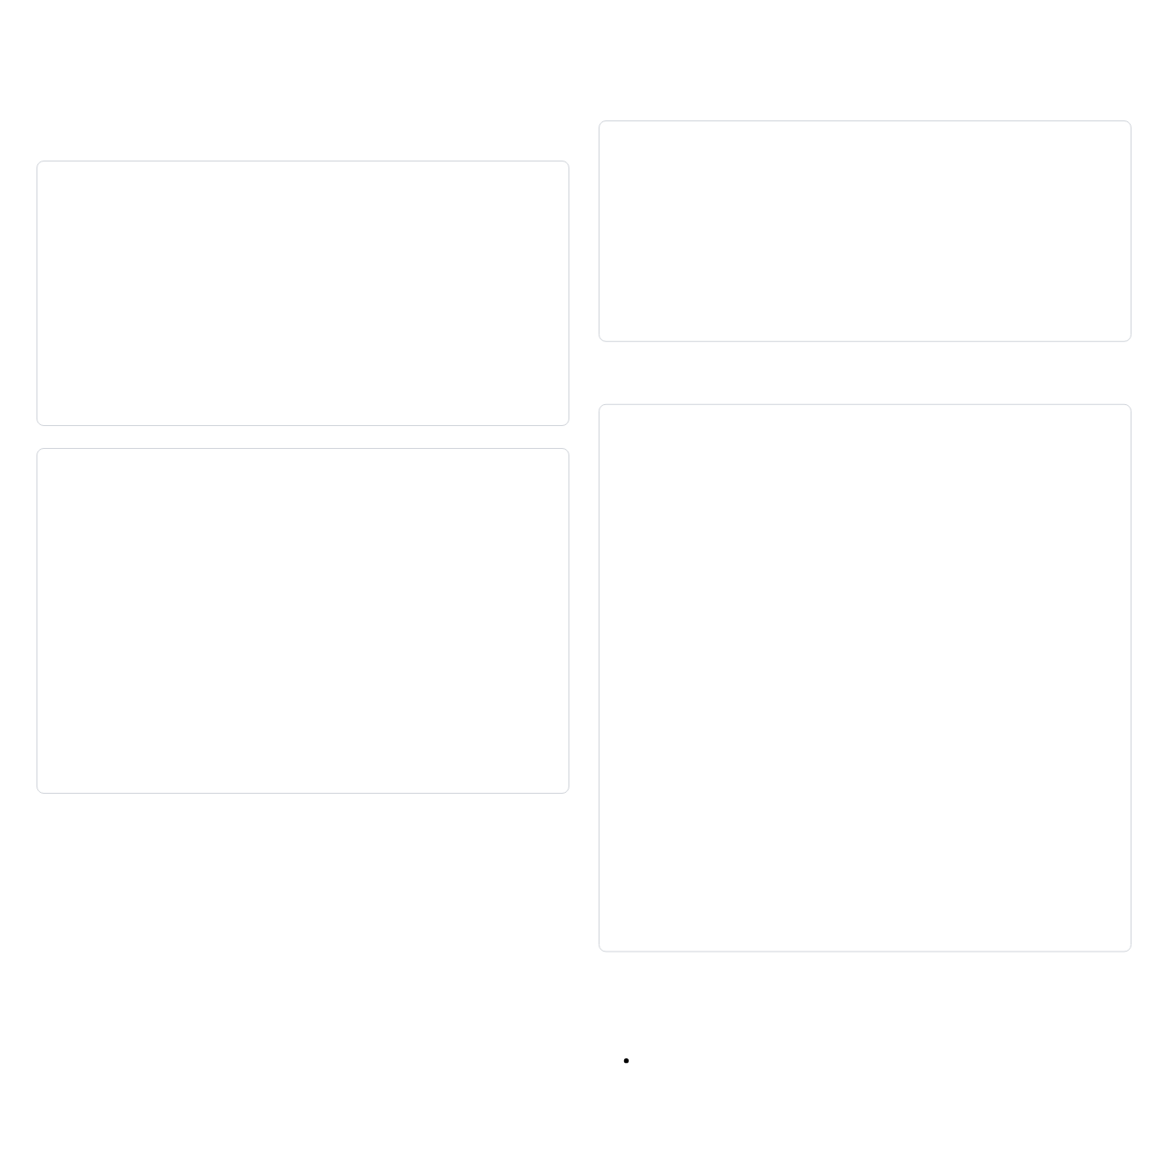
Setting Up Bootstrap
Including Bootstrap in Your Project
3. Download Files
1. CDN Method
Download compiled CSS and JS from the Bootstrap website.
<!-- Local files -->
<link href="css/bootstrap.min.css" rel="stylesheet">
<script src="js/bootstrap.bundle.min.js"></script>
<!-- CSS only -->
<link href="https://cdn.jsdelivr.net/npm/bootstrap@5.3.0/dist/css/bootstrap.min.css" rel="stylesheet">
<!-- JavaScript Bundle with Popper -->
<script src="https://cdn.jsdelivr.net/npm/bootstrap@5.3.0/dist/js/bootstrap.bundle.min.js"></script>
Basic Template
Advantages: Quick setup, no downloads, cached by browsers
2. Package Manager (npm)
<!DOCTYPE html>
<html lang="en">
<head>
<meta charset="UTF-8">
<meta name="viewport" content="width=device-width, initial-scale=1.0">
<link href="https://cdn.jsdelivr.net/npm/bootstrap@5.3.0/dist/css/bootstrap.min.css" rel="stylesheet">
<title>Bootstrap Example</title>
</head>
<body>
<div class="container">
<h1>Hello, Bootstrap!</h1>
<p class="lead">This is a Bootstrap example.</p>
<button class="btn btn-primary">Click Me</button>
</div>
<script src="https://cdn.jsdelivr.net/npm/bootstrap@5.3.0/dist/js/bootstrap.bundle.min.js"></script>
</body>
</html>
npm install bootstrap
Then import in your JavaScript:
Further Reading:
Bootstrap - Download
|
Bootstrap - Introduction
// Import all of Bootstrap's JS
import * as bootstrap from 'bootstrap'
// Import Bootstrap's CSS
import 'bootstrap/dist/css/bootstrap.min.css'
Important Notes:
Always include the viewport meta tag for responsive designs
Bootstrap requires a containing element (like
)
.container
Include JavaScript bundle for interactive components
Bootstrap 5 no longer requires jQuery

Slide 19
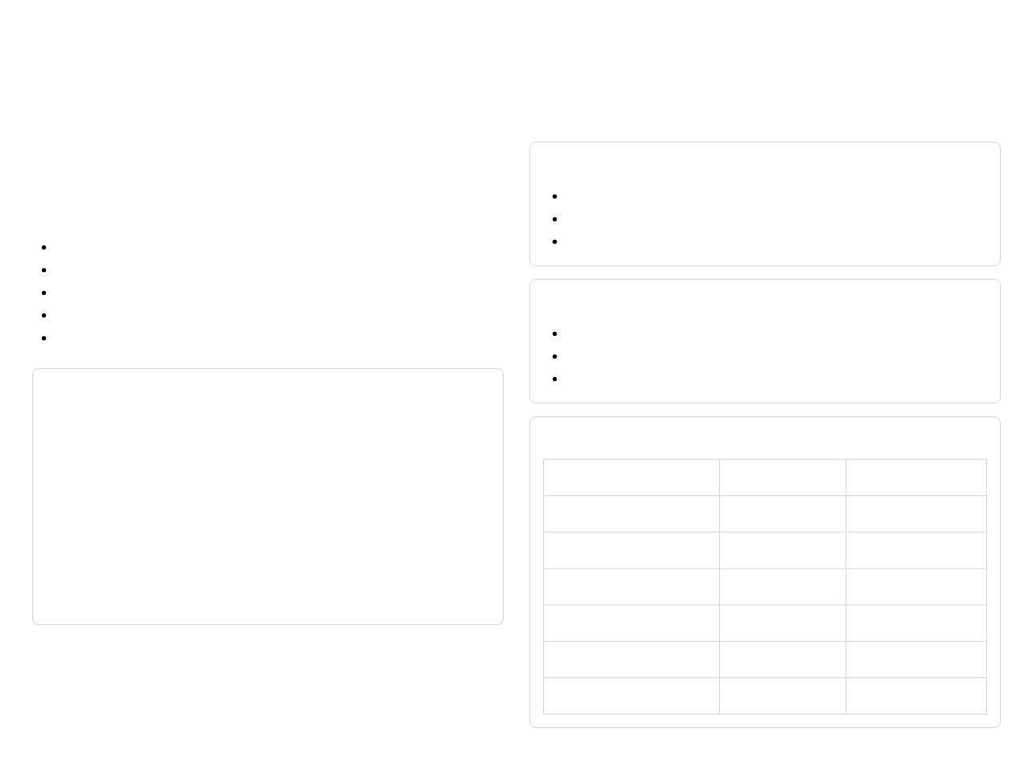
Bootstrap Grid System
Understanding the Grid System
Grid Classes
Bootstrap's grid system uses a series of containers, rows, and columns to layout and align content.
Container Classes
.container
: Fixed-width container
Key Concepts:
.container-fluid
: Full-width container
12-Column System:
Each row is divided into 12 columns
.container-{breakpoint}
: Width changes at breakpoint
Responsive Breakpoints:
xs, sm, md, lg, xl, xxl
Container Types:
fixed-width or full-width
Column Classes
Rows:
Horizontal groups of columns
Columns:
Content containers with variable widths
.col
: Equal-width columns
.col-{size}
: Columns spanning specific number of units
Basic Grid Structure
.col-{breakpoint}-{size}
: Responsive columns
<div class="container">
<div class="row">
<div class="col-sm-6 col-md-4">Column 1</div>
<div class="col-sm-6 col-md-4">Column 2</div>
<div class="col-sm-12 col-md-4">Column 3</div>
</div>
</div>
Breakpoints
Breakpoint
Class infix
Dimensions
Extra small
None
<576px
Small
sm
≥576px
Further Reading:
Bootstrap - Grid System
|
Bootstrap - Breakpoints
Medium
md
≥768px
Large
lg
≥992px
Extra large
xl
≥1200px
Extra extra large
xxl
≥1400px

Slide 20

Bootstrap Components
Common Bootstrap Components
Navigation Bar
Buttons
<nav class="navbar navbar-expand-lg navbar-light bg-light">
<div class="container-fluid">
<a class="navbar-brand" href="#">Brand</a>
<button class="navbar-toggler" type="button"
data-bs-toggle="collapse"
data-bs-target="#navbarNav">
<span class="navbar-toggler-icon"></span>
</button>
<div class="collapse navbar-collapse" id="navbarNav">
<ul class="navbar-nav">
<li class="nav-item">
<a class="nav-link active" href="#">Home</a>
</li>
<li class="nav-item">
<a class="nav-link" href="#">Features</a>
</li>
<li class="nav-item">
<a class="nav-link" href="#">Pricing</a>
</li>
</ul>
</div>
</div>
</nav>
<button type="button" class="btn btn-primary">Primary</button>
<button type="button" class="btn btn-secondary">Secondary</button>
<button type="button" class="btn btn-success">Success</button>
<button type="button" class="btn btn-danger">Danger</button>
<button type="button" class="btn btn-warning">Warning</button>
<button type="button" class="btn btn-info">Info</button>
<button type="button" class="btn btn-light">Light</button>
<button type="button" class="btn btn-dark">Dark</button>
<button type="button" class="btn btn-link">Link</button>
Button Groups
<div class="btn-group" role="group">
<button type="button" class="btn btn-primary">Left</button>
<button type="button" class="btn btn-primary">Middle</button>
<button type="button" class="btn btn-primary">Right</button>
</div>
Further Reading:
Bootstrap - Components
|
Bootstrap - Examples
Alerts
<div class="alert alert-primary" role="alert">
A simple primary alert
</div>
<div class="alert alert-success" role="alert">
A simple success alert with
<a href="#" class="alert-link">an example link</a>
</div>
Cards
<div class="card" style="width: 18rem;">
<div class="card-header">
Featured
</div>
<div class="card-body">
<h5 class="card-title">Card title</h5>
<p class="card-text">Some quick example text.</p>
<a href="#" class="btn btn-primary">Go somewhere</a>
</div>
<div class="card-footer">
2 days ago
</div>
</div>
Other Common Components:
Forms and form controls
Dropdowns
Modals
Carousels
Pagination
Badges
Progress bars
Spinners
Toasts

Slide 21

Practice: Bootstrap
Exercise 1: Create a Responsive Grid Layout
Exercise 2: Build a Navigation Bar
HTML Structure
HTML Structure
<div class="container">
<div class="row">
<div class="col-sm-12 col-md-4 col-lg-4">
<div class="p-3 border bg-light">Column 1</div>
</div>
<div class="col-sm-12 col-md-4 col-lg-4">
<div class="p-3 border bg-light">Column 2</div>
</div>
<div class="col-sm-12 col-md-4 col-lg-4">
<div class="p-3 border bg-light">Column 3</div>
</div>
</div>
</div>
<nav class="navbar navbar-expand-lg navbar-light bg-light">
<div class="container-fluid">
<a class="navbar-brand" href="#">Brand</a>
<button class="navbar-toggler" type="button"
data-bs-toggle="collapse"
data-bs-target="#navbarNav">
<span class="navbar-toggler-icon"></span>
</button>
<div class="collapse navbar-collapse" id="navbarNav">
<ul class="navbar-nav">
<li class="nav-item">
<a class="nav-link active" href="#">Home</a>
</li>
<li class="nav-item">
<a class="nav-link" href="#">Features</a>
</li>
<li class="nav-item">
<a class="nav-link" href="#">Pricing</a>
</li>
</ul>
</div>
</div>
</nav>
Further Reading:
Bootstrap - Examples
|
W3Schools - Bootstrap Exercises
This creates a 3-column layout that stacks on mobile devices (small screens).
Challenge:
Modify the grid to have:
2 columns on medium screens
4 columns on large screens
Add appropriate spacing and styling
Challenge:
Enhance the navbar by:
Adding a dropdown menu
Including a search form
Changing the color scheme
Making sure it collapses properly on mobile
Exercise 3: Create a Card-Based Layout
Create a grid of cards with:
Images at the top
Titles, text, and buttons
Responsive layout (3 columns on desktop, 2 on tablet, 1 on mobile)
Consistent spacing between cards

Slide 22
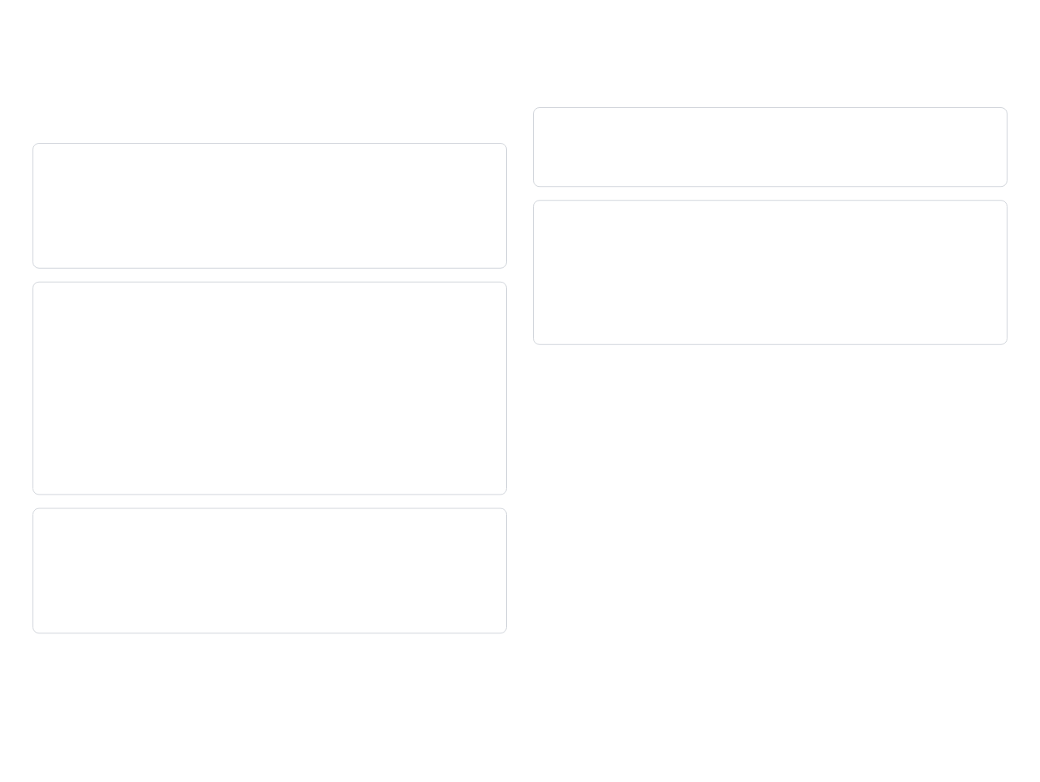
Session 2: Assessment
Quick Quiz
4. How many columns are in Bootstrap's grid system?
1. What is the difference between Flexbox and Grid?
Answer: 12 columns
Answer: Flexbox is one-dimensional (row OR column) and content-first, while Grid is two-dimensional (rows AND columns) and layout-first.
5. How do you create a responsive column that takes up half the width on medium screens and full width on small screens?
2. How do you create a 3-column grid layout using CSS Grid?
<div class="col-12 col-md-6">Content</div>
.container {
display: grid;
grid-template-columns: repeat(3, 1fr);
gap: 20px;
}
Key Takeaways from Session 2
CSS Grid is ideal for two-dimensional layouts
Media queries enable responsive design
Mobile-first approach starts with mobile styles
Bootstrap provides a comprehensive framework
Bootstrap's 12-column grid system simplifies layouts
3. What is the purpose of the viewport meta tag?
Bootstrap components speed up development
Answer: It tells the browser to set the viewport width to the device width and set the initial zoom level, which is essential for responsive design.
Further Reading:
Bootstrap - Examples
|
CSS-Tricks - A Complete Guide to Grid
Homework Assignment:
Create a responsive webpage with Bootstrap that includes:
A responsive navbar with dropdown
A grid layout with different column arrangements at different breakpoints
At least three different Bootstrap components
Custom styling to override Bootstrap defaults

Slide 23
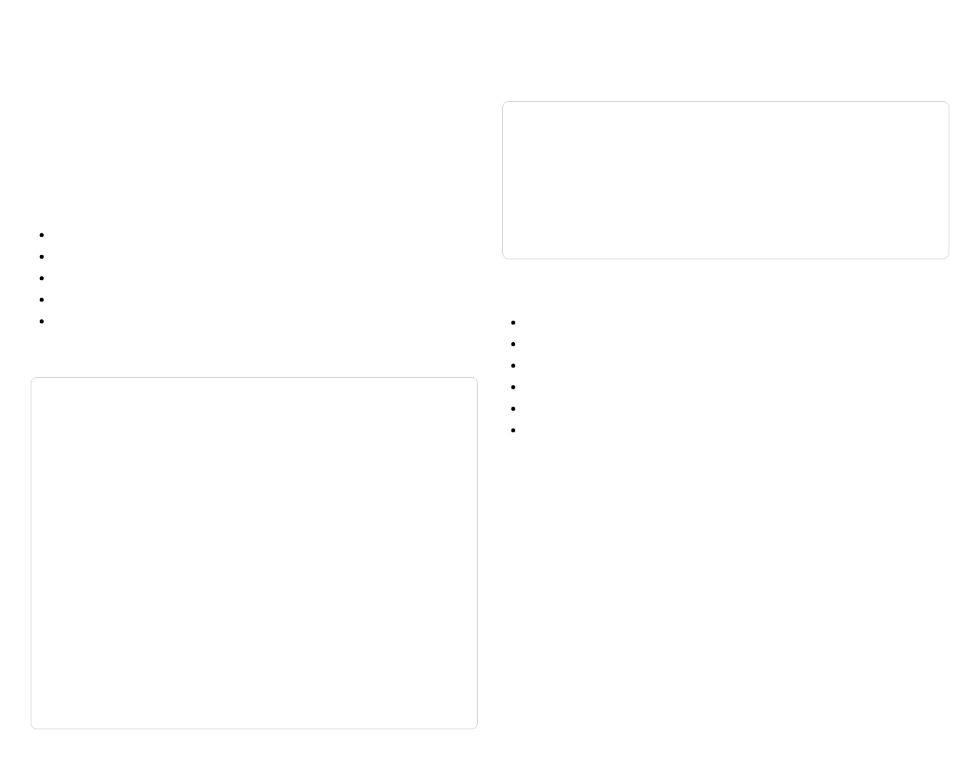
Introduction to TailwindCSS
What is TailwindCSS?
Utility-First (Tailwind):
TailwindCSS is a utility-first CSS framework that allows you to build custom designs without leaving your HTML.
<div class="bg-white rounded-lg p-6 shadow-md">
Content goes here
</div>
Key Concepts:
Utility-First:
Compose designs with utility classes
Low-Level:
Small, single-purpose classes
Highly Customizable:
Tailored to your design system
Why Use TailwindCSS?
Mobile-First:
Responsive design built-in
Modern:
Designed for modern development workflows
No More Custom CSS:
Build custom designs without writing CSS
Consistent Design:
Constraints help maintain consistency
Traditional CSS vs. Utility-First:
Responsive Design:
Built-in responsive modifiers
Dark Mode:
Easy dark mode implementation
Traditional CSS:
Smaller File Size:
Only includes the utilities you use
Component Extraction:
Extract components when needed
/* CSS */
.card {
background-color: white;
border-radius: 0.5rem;
padding: 1.5rem;
box-shadow: 0 2px 4px rgba(0, 0, 0, 0.1);
}
/* HTML */
<div class="card">
Content goes here
</div>
When to Use TailwindCSS:
When you want full control over your design
Further Reading:
Tailwind CSS Documentation
|
Utility-First Fundamentals
When you need a highly customized UI
When you want to avoid writing custom CSS
When you're building a design system from scratch
When you prefer working in HTML over CSS files

Slide 24
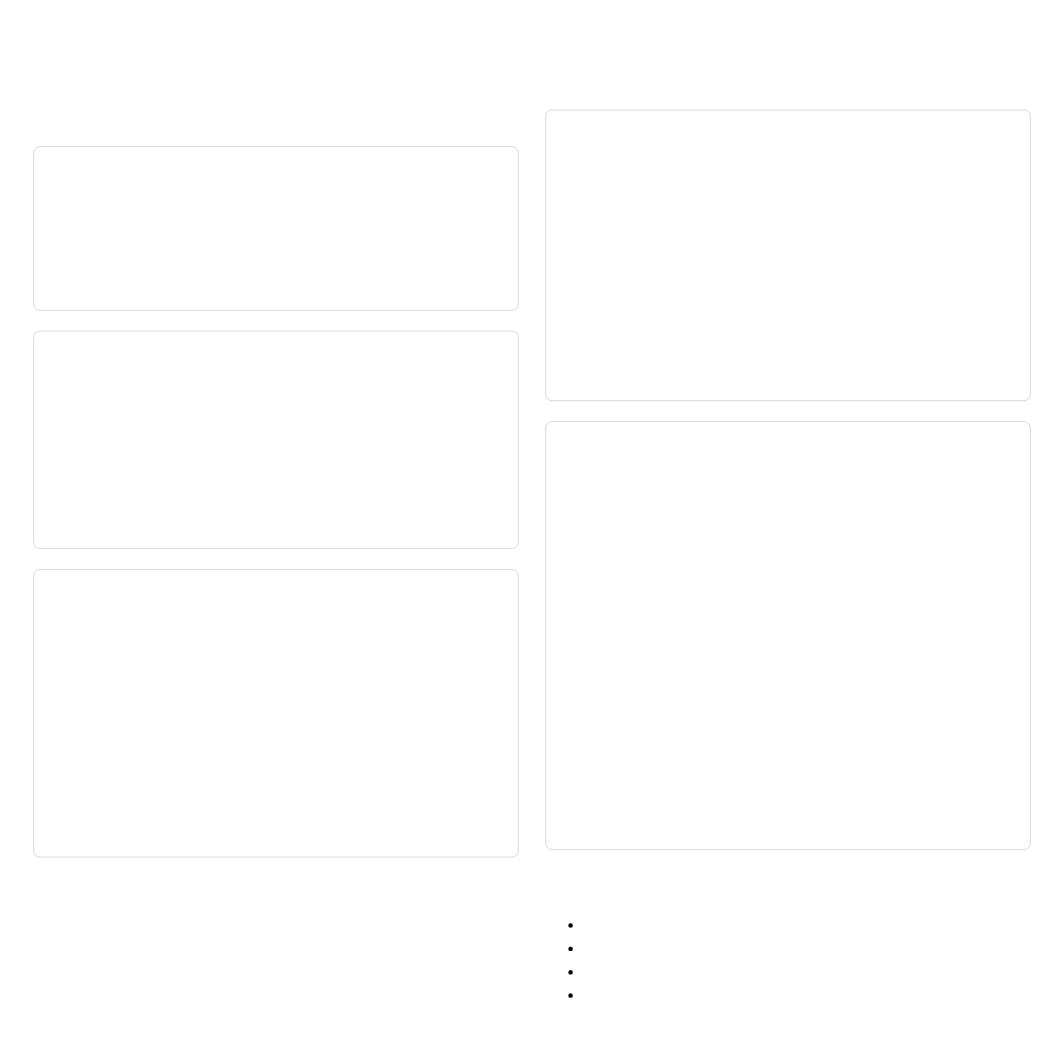
Setting Up TailwindCSS
Installation Methods
CSS File Setup
1. CDN (For Testing Only)
/* src/input.css */
@tailwind base;
@tailwind components;
@tailwind utilities;
<!-- Add to head of HTML -->
<script src="https://cdn.tailwindcss.com"></script>
Note: Not recommended for production due to larger file size and lack of customization
Then build the CSS:
2. Using npm
npx tailwindcss -i ./src/input.css -o ./dist/output.css --watch
# Install Tailwind CSS
npm install -D tailwindcss
# Generate tailwind.config.js
npx tailwindcss init
HTML Setup
<!DOCTYPE html>
<html lang="en">
<head>
<meta charset="UTF-8">
<meta name="viewport" content="width=device-width, initial-scale=1.0">
<link href="./dist/output.css" rel="stylesheet">
<title>Tailwind CSS Example</title>
</head>
<body>
<h1 class="text-3xl font-bold text-center text-blue-600">
Hello Tailwind!
</h1>
</body>
</html>
Further Reading:
Tailwind CSS - Installation
|
Tailwind CSS - Configuration
Configuration File (tailwind.config.js)
/** @type {import('tailwindcss').Config} */
module.exports = {
content: ["./src/**/*.{html,js}"],
theme: {
extend: {},
},
plugins: [],
}
Framework Integration:
React/Next.js:
npm install -D tailwindcss postcss autoprefixer
Vue/Nuxt:
npm install -D @nuxtjs/tailwindcss
Angular:
ng add @ngneat/tailwind
Laravel:
npm install -D tailwindcss postcss autoprefixer

Slide 25
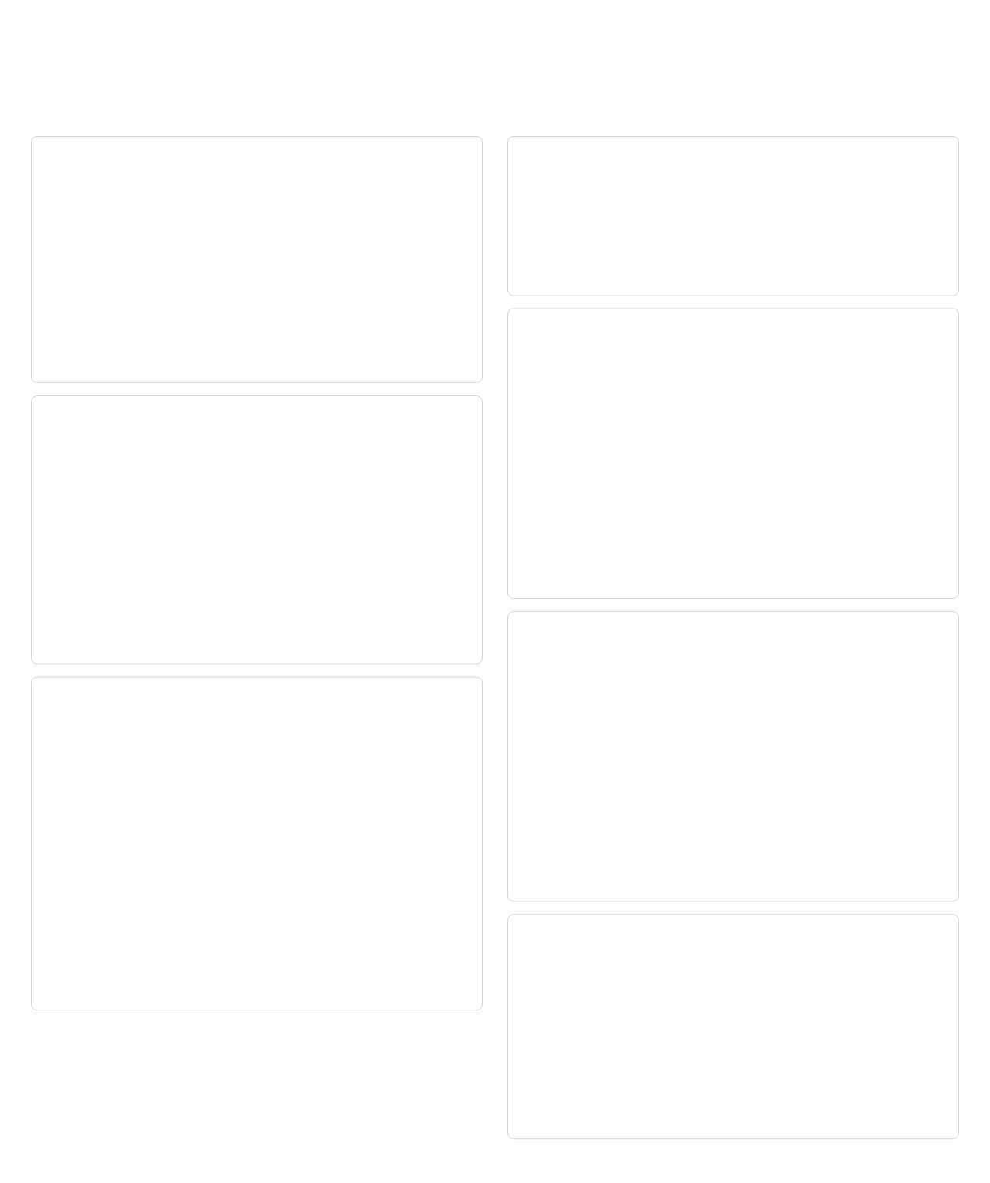
Tailwind Utilities
Spacing Utilities
Typography Utilities
Padding
Font Family
p-4 /* padding on all sides: 1rem */
px-4 /* padding left/right: 1rem */
py-4 /* padding top/bottom: 1rem */
pt-4 /* padding top: 1rem */
pr-4 /* padding right: 1rem */
pb-4 /* padding bottom: 1rem */
pl-4 /* padding left: 1rem */
font-sans /* System UI sans-serif */
font-serif /* Serif fonts */
font-mono /* Monospace fonts */
Font Size
text-xs /* 0.75rem */
text-sm /* 0.875rem */
text-base /* 1rem (default) */
text-lg /* 1.125rem */
text-xl /* 1.25rem */
text-2xl /* 1.5rem */
text-3xl /* 1.875rem */
text-4xl /* 2.25rem */
text-5xl /* 3rem */
Margin
m-4 /* margin on all sides: 1rem */
mx-4 /* margin left/right: 1rem */
my-4 /* margin top/bottom: 1rem */
mt-4 /* margin top: 1rem */
mr-4 /* margin right: 1rem */
mb-4 /* margin bottom: 1rem */
ml-4 /* margin left: 1rem */
-m-4 /* negative margin: -1rem */
Further Reading:
Tailwind CSS - Spacing
|
Tailwind CSS - Typography
Font Weight
font-thin /* 100 */
font-extralight /* 200 */
font-light /* 300 */
font-normal /* 400 */
font-medium /* 500 */
font-semibold /* 600 */
font-bold /* 700 */
font-extrabold /* 800 */
font-black /* 900 */
Space Between
<div class="space-y-4">
<div>Item 1</div>
<div>Item 2</div>
<div>Item 3</div>
</div>
<div class="flex space-x-4">
<div>Item 1</div>
<div>Item 2</div>
<div>Item 3</div>
</div>
Text Color
text-black
text-white
text-gray-500
text-red-600
text-blue-700
text-opacity-75 /* 75% opacity */

Slide 26
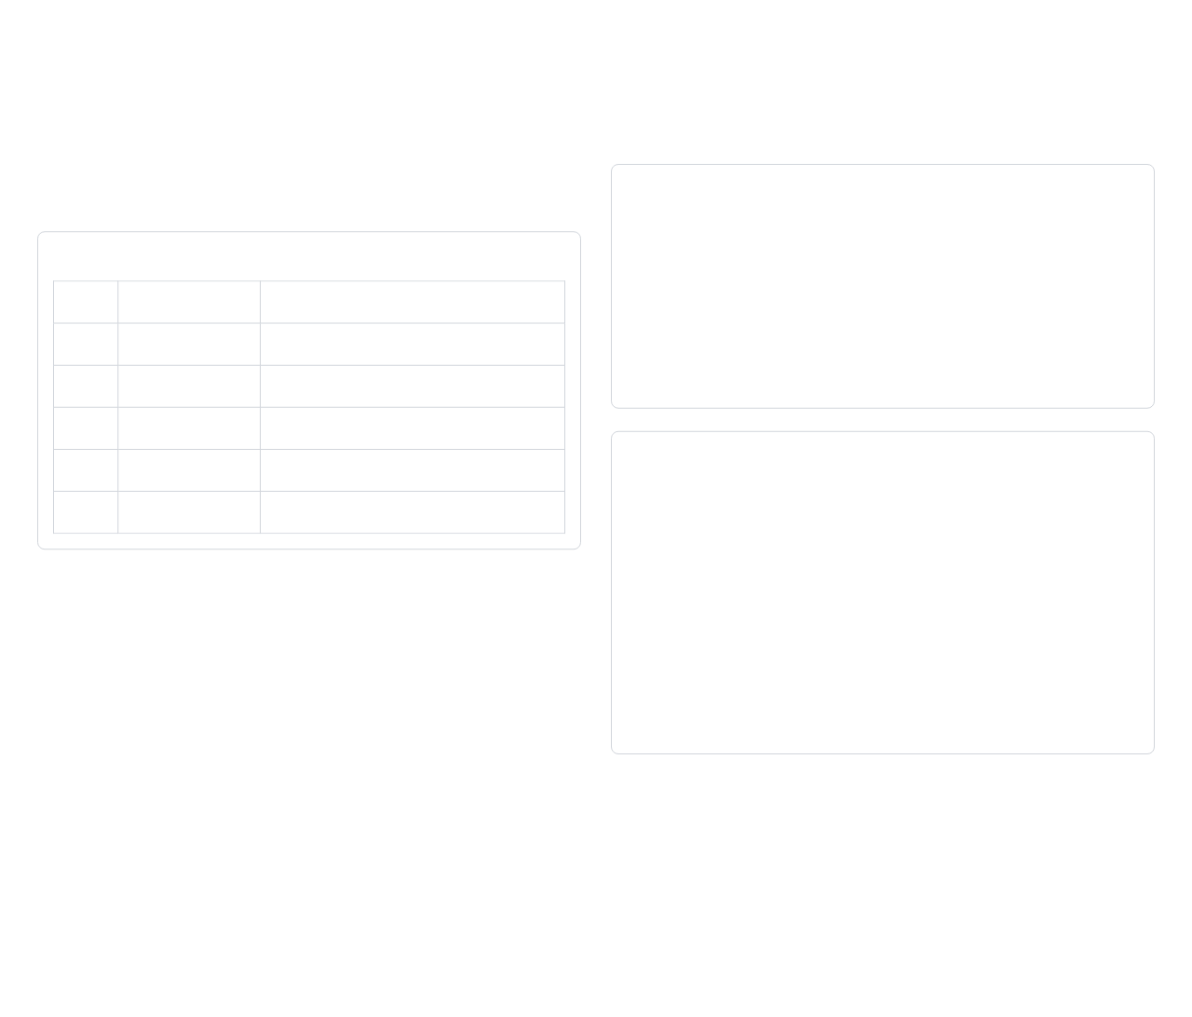
Responsive Design with Tailwind
Responsive Breakpoints
Using Responsive Prefixes
Tailwind includes responsive variants that let you apply different styles at different screen sizes.
Responsive Syntax
Default Breakpoints
<div class="w-full md:w-1/2 lg:w-1/3">
This div is full width on mobile,
half width on medium screens,
and one-third width on large screens.
</div>
Prefix
Minimum width
CSS
640px
sm
@media (min-width: 640px) { ... }
768px
md
@media (min-width: 768px) { ... }
1024px
lg
@media (min-width: 1024px) { ... }
1280px
Responsive Grid Example
xl
@media (min-width: 1280px) { ... }
1536px
2xl
@media (min-width: 1536px) { ... }
<div class="grid grid-cols-1 md:grid-cols-2 lg:grid-cols-3 gap-4">
<div class="bg-gray-200 p-4">Item 1</div>
<div class="bg-gray-200 p-4">Item 2</div>
<div class="bg-gray-200 p-4">Item 3</div>
<div class="bg-gray-200 p-4">Item 4</div>
<div class="bg-gray-200 p-4">Item 5</div>
<div class="bg-gray-200 p-4">Item 6</div>
</div>
Further Reading:
Tailwind CSS - Responsive Design
|
Tailwind CSS - Breakpoints
Mobile-First Approach:
Tailwind uses a mobile-first approach, where unprefixed utilities apply to all screen sizes, and prefixed utilities apply at the specified breakpoint and above.
This means you should start with the mobile design and then add responsive prefixes for larger screens.

Slide 27
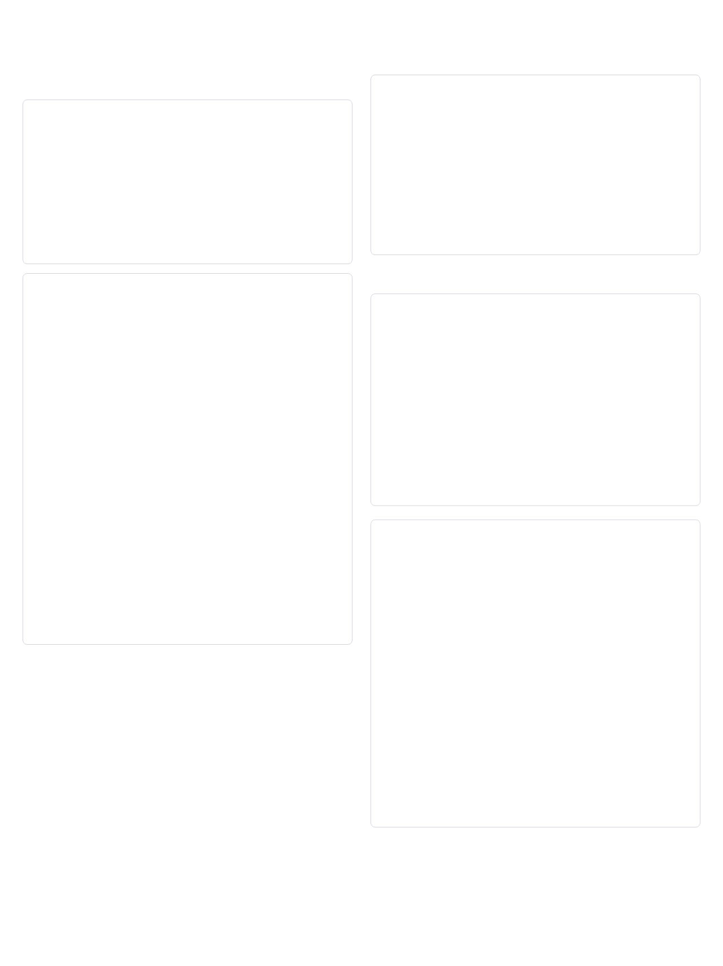
Building Components with Tailwind
Creating Common UI Elements
Form Input
Button
<input class="shadow appearance-none border
rounded w-full py-2 px-3
text-gray-700 leading-tight
focus:outline-none
focus:shadow-outline"
type="text"
placeholder="Username">
<button class="bg-blue-500 hover:bg-blue-700
text-white font-bold py-2 px-4
rounded focus:outline-none
focus:shadow-outline">
Click Me
</button>
Customizing Components
Card
Using @apply Directive
<div class="max-w-sm rounded overflow-hidden
shadow-lg">
<div class="px-6 py-4">
<div class="font-bold text-xl mb-2">
Card Title
</div>
<p class="text-gray-700 text-base">
Card content goes here.
</p>
</div>
<div class="px-6 pt-4 pb-2">
<span class="inline-block bg-gray-200
rounded-full px-3 py-1
text-sm font-semibold
text-gray-700 mr-2 mb-2">
#tag1
</span>
</div>
</div>
/* In your CSS file */
.btn {
@apply bg-blue-500 hover:bg-blue-700
text-white font-bold py-2 px-4
rounded;
}
/* Then in your HTML */
<button class="btn">Click Me</button>
Further Reading:
Tailwind CSS - Extracting Components
|
Tailwind CSS - Theme Configuration
Extending the Theme
// tailwind.config.js
module.exports = {
theme: {
extend: {
colors: {
'brand': '#3490dc',
},
spacing: {
'72': '18rem',
'84': '21rem',
'96': '24rem',
}
}
}
}
Component Extraction Strategies:
Use @apply for frequently used patterns
Create reusable components in your framework
Use JavaScript functions to generate class strings
Consider utility libraries like clsx or classnames

Slide 28
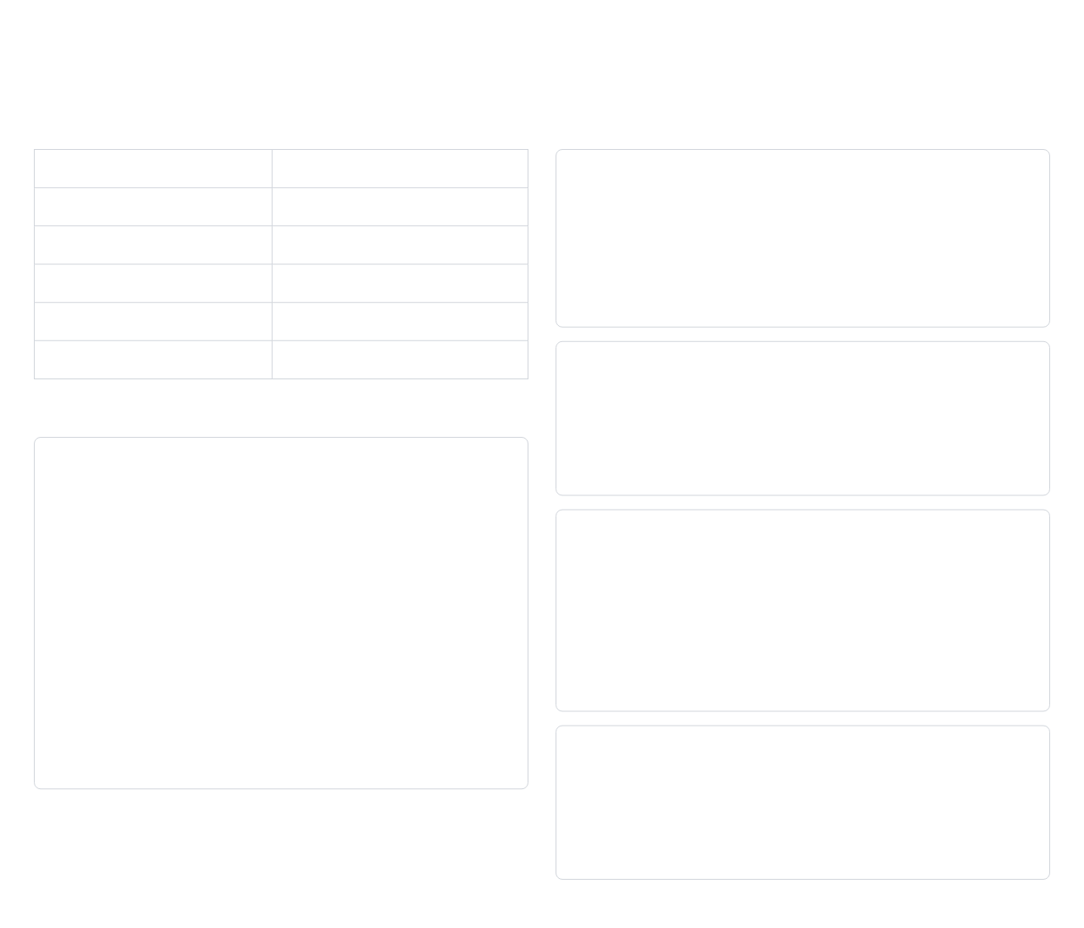
Bootstrap vs TailwindCSS
Philosophy Differences
Pros and Cons
Bootstrap
TailwindCSS
Bootstrap Pros:
Component-based approach
Utility-first approach
Quick prototyping with pre-built components
Pre-designed components
No pre-designed components
Consistent design out of the box
Extensive documentation and community support
Opinionated design
Design agnostic
Less HTML markup for common components
Easier for beginners
"Batteries included"
"Build your own components"
Faster initial development
More flexible and customizable
Bootstrap Cons:
Opinionated design is harder to customize
Code Comparison
Heavier file size if using all components
Websites can look "bootstrapy"
Button Example
Requires JavaScript for some components
Bootstrap:
Tailwind Pros:
<button class="btn btn-primary">Button</button>
Highly customizable
Further Reading:
Bootstrap Documentation
|
Tailwind CSS Documentation
No unnecessary CSS
Tailwind:
Consistent design system
<button class="bg-blue-500 hover:bg-blue-700
text-white font-bold py-2 px-4
rounded">
Button
</button>
Responsive design built-in
No need to write custom CSS
Smaller file size in production (with PurgeCSS)
Tailwind Cons:
Steeper learning curve
HTML can become verbose
No pre-built components
Requires build step for optimal performance

Slide 29
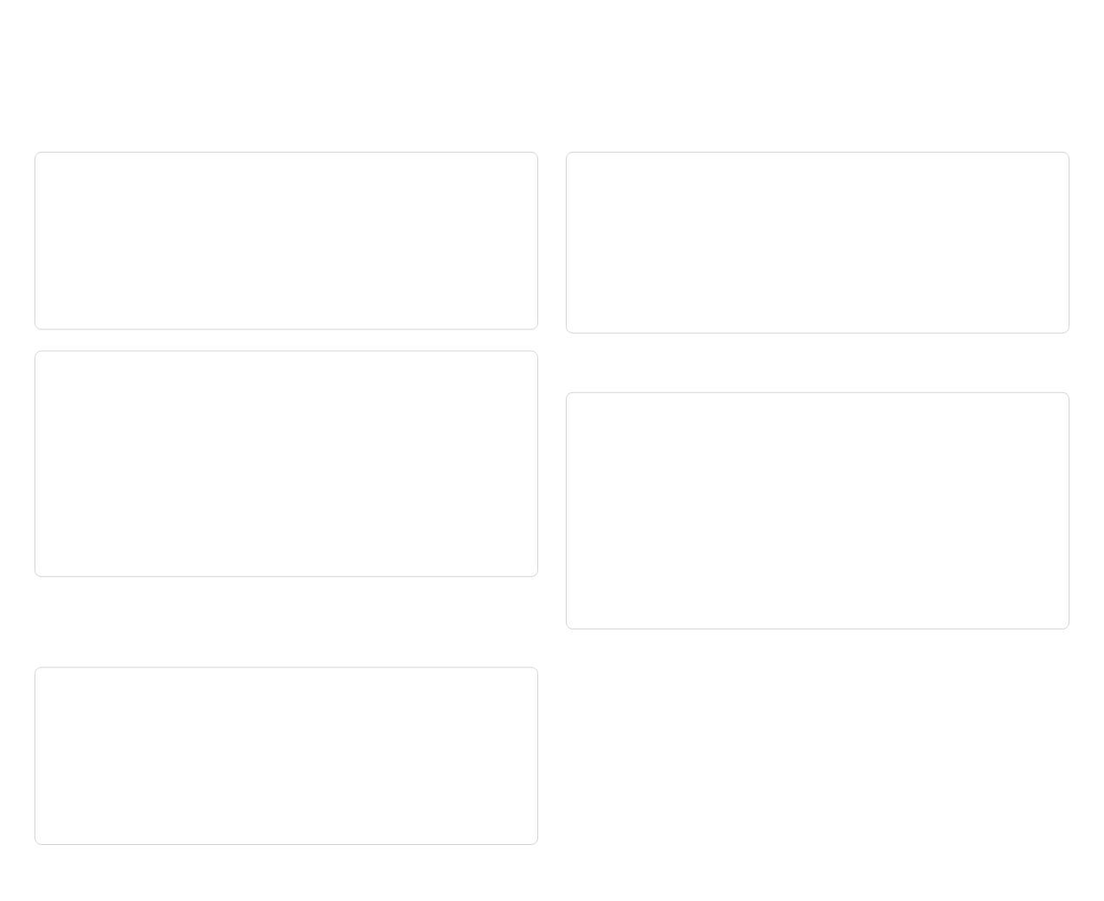
Practice: Framework Comparison
Exercise 1: Convert Bootstrap to Tailwind
Exercise 2: Build the Same Component in Both Frameworks
Bootstrap Button
Task: Create a Navbar
Create a simple navigation bar with:
<button class="btn btn-primary">
Submit
</button>
Brand/logo on the left
Navigation links on the right
Responsive behavior (collapses on mobile)
Active state for current page
Tailwind Equivalent
Exercise 3: Customize Components
Task: Create a Custom Card
<button class="bg-blue-600 hover:bg-blue-700
text-white font-medium py-2 px-4
rounded">
Submit
</button>
Create a card component with:
Custom border radius
Custom shadow
Custom background color
Custom hover effect
Implement this in both Bootstrap (using custom CSS) and Tailwind, then compare the approaches.
Further Reading:
Tailwind CSS - Utility-First Fundamentals
|
Bootstrap - Customize
Challenge:
Convert this Bootstrap alert to Tailwind CSS:
Discussion Points:
Which framework was easier to work with?
<div class="alert alert-success" role="alert">
This is a success alert with
<a href="#" class="alert-link">an example link</a>
</div>
Which approach resulted in cleaner code?
Which approach was more flexible?
Which approach would be better for a large project?
Which approach would be better for a team?

Slide 30
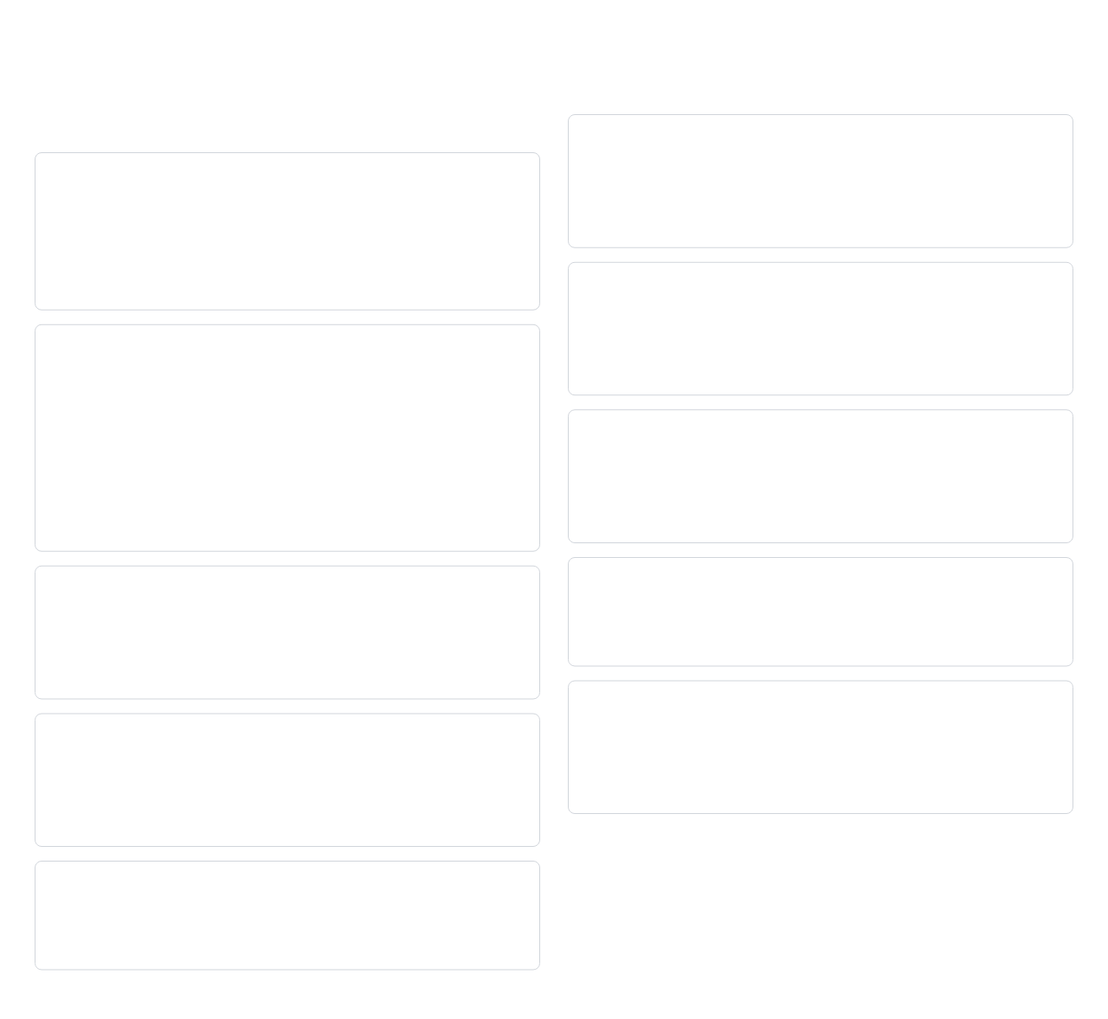
Final Assessment
Comprehensive Quiz
6. What is the box model and how does it affect layout?
1. What is the main difference between Bootstrap and Tailwind CSS?
Answer: The box model describes how elements are rendered with content, padding, border, and margin. It affects layout calculations and spacing between elements.
Answer: Bootstrap is a component-based framework with pre-designed components, while Tailwind is a utility-first framework that provides low-level utility classes to build custom designs.
7. Explain the difference between flexbox and grid layouts.
Answer: Flexbox is one-dimensional (row OR column) and content-first, while Grid is two-dimensional (rows AND columns) and layout-first.
2. How do you create a responsive grid in Tailwind CSS?
<div class="grid grid-cols-1 md:grid-cols-2 lg:grid-cols-3 gap-4">
<div>Item 1</div>
<div>Item 2</div>
<div>Item 3</div>
</div>
8. How do media queries work and why are they important?
Answer: Media queries apply CSS rules based on device characteristics (like screen width). They're essential for creating responsive designs that adapt to different screen sizes.
3. What is the purpose of utility classes in Tailwind?
9. What are the advantages of using a CSS framework?
Further Reading:
MDN Web Docs - CSS
|
CSS-Tricks
Answer: Utility classes provide single-purpose styling that can be applied directly in HTML, allowing developers to build custom designs without writing CSS.
Answer: Faster development, consistent design, cross-browser compatibility, responsive layouts, and community support.
10. How would you implement a dark mode toggle using CSS?
4. When would you choose Bootstrap over Tailwind CSS?
Answer: Use CSS custom properties (variables) for colors, then toggle a class on the root element that changes these variables. With Tailwind, use the dark mode feature and dark: variant.
Answer: Choose Bootstrap when you need rapid development with pre-built components, consistent design out of the box, or when working with a team less experienced with CSS.
5. How do you customize the default theme in Tailwind CSS?
Answer: By extending or overriding values in the theme section of the tailwind.config.js file.

Slide 31
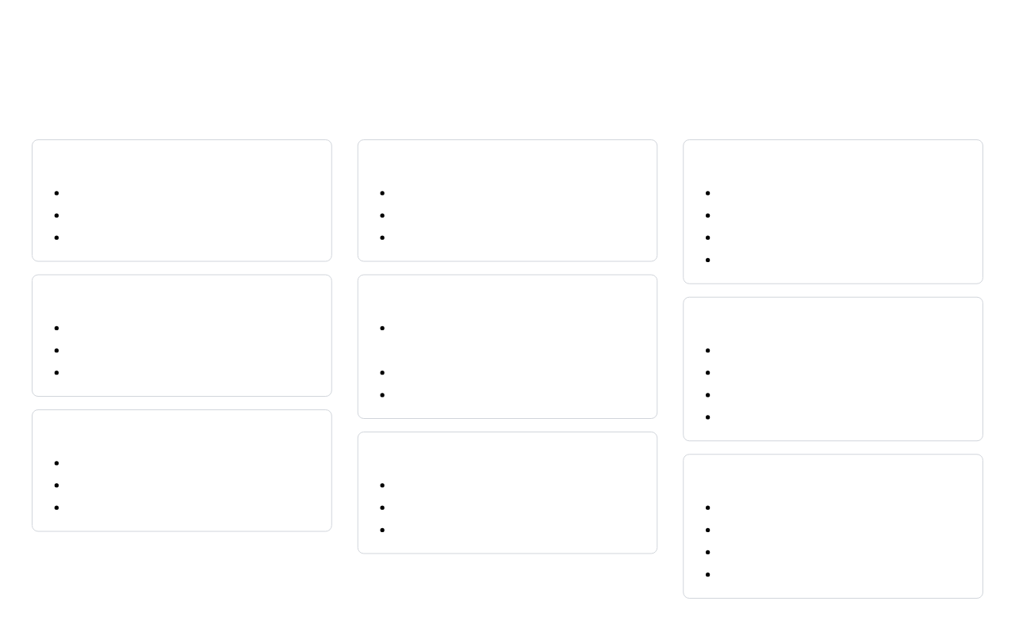
Resources for Further Learning
Official Documentation
Interactive Learning
Community and Tools
CSS
CSS Games
Communities
MDN Web Docs - CSS
Flexbox Froggy
Stack Overflow - CSS
W3C CSS Working Group
Grid Garden
CSS-Tricks Forums
W3Schools CSS Tutorial
CSS Diner (Selectors)
Tailwind CSS Discord
Bootstrap Spectrum
Bootstrap
Online Courses
Bootstrap Documentation
freeCodeCamp - Responsive Web Design
Helpful Tools
Bootstrap Examples
Can I Use (Browser Support)
Bootstrap Blog
Scrimba - Learn Tailwind CSS
CSS Gradient Generator
Codecademy - Learn Bootstrap
Animista (CSS Animations)
ColorZilla
TailwindCSS
Tailwind CSS Documentation
Coding Challenges
Tailwind UI (Components)
Frontend Mentor
Blogs and Newsletters
Tailwind Play (Playground)
CodePen Challenges
CSS-Tricks
100 Days CSS Challenge
web.dev Blog
These resources will help you continue your learning journey in CSS, Bootstrap, and TailwindCSS.
CSS Weekly
Frontend Focus

Slide 32




Thank You!
CSS3, Bootstrap & TailwindCSS
You've completed the course!
Continue practicing and building projects to strengthen your skills.
CSS3
Bootstrap
TailwindCSS
Questions? Contact:
instructor@example.com
Next Steps:
MDN Web Docs
|
Bootstrap Docs
|
Tailwind Docs

